Slide 1
American Clinical Neurophysiology Society’s Standardized Critical Care EEG Terminology
2012 Version
TRAINING MODULE

Slide 2
Why
No current consensus on terminology for many periodic, rhythmic, quasi-periodic, quasi-rhythmic, and fluctuating patterns seen in encephalopathic patients.
No consensus or data on which patterns are associated with neuronal injury, which require treatment, and how aggressively to treat.

Slide 3
Primary objectives
Develop standardized terminology for scientific investigation related to rhythmic and periodic EEG patterns seen in encephalopathic patients
  Avoid loaded clinical terms (e.g. triphasic waves)
  Avoid “ictal”, “interictal” and “epileptiform” for these equivocal patterns (e.g. the E in PLEDs)
Allow collaborative, multicenter studies
Allow comparison of results between centers
Continuous EEG Monitoring Consortium Training Module

Slide 4
Secondary objectives
Standardize
  quantification of interictal discharges
  description/categorization of background
Develop a database using these standard terms and make it widely available

Slide 5
Not included in this nomenclature
Does not include unequivocal electrographic seizures:
  GS&W > 3/s
  Evolving discharges that reach > 4/s
Does include all other rhythmic and periodic patterns:
  GS&W < 3/s
  Evolving discharges that remain < 4/s
  This does not imply that these patterns are not ictal, simply that they may or may not be

Slide 6
Ages
Not intended for use in neonates.
Applies at all other ages.

Slide 7
Main Terms for
Rhythmic and Periodic patterns
Describe with main term # 1 followed by #2, with modifiers added as appropriate.
Main term #1 (G) Generalized (L) Lateralized (BI) Bilateral Independent (Mf) Multifocal | Main term #2 (PDs) Periodic Discharges (RDA) Rhythmic Delta Activity (SW) (Poly)Spike-&-Wave/Sharp-and-Wave

Slide 8
Main Term #1: Optional additional informations
For G: Specify
  frontally predominant ( = amplitude anterior derivations >50% that in posterior derivations on ipsilateral ear, average, or noncephalic referential recording)
  occipitally predominant
  midline predominant (= amplitude in midline derivations that is at least 50% greater than in parasagittal derivations on an average or non-cephalic referential recording)
  generalized, not otherwise specified
For L: specify
  lobe(s) most involved or hemispheric
  unilateral vs bilateral asymmetric
For BI and Mf: specify
  lobe(s) most involved or hemispheric
  bilateral symmetric vs bilateral asymmetric
Notes:
Midline-predominant added

Slide 9
Main Term #1: Optional additional informations
  For the purpose of this nomenclature, the term “generalized” refers to any bilateral, bisynchronous and symmetric pattern, even if it has a restricted field [e.g. bifrontal])”
  Bifrontal or bioccipital patterns are termed ‘generalized, with frontal predominance’ or ‘generalized, with occipital predominance’
Patterns that are regional or focal would be called “lateralized”
Patterns seen bilaterally but clearly more prominent on one side would be called “Lateralized, bilateral asymmetric” (NOT generalized )
Notes:
First bullet point added

Slide 10
Main Term #2
PD: Periodic Discharges
RDA: Rhythmic Delta Activity
SW: Spike-and-Wave, Sharp-and-Wave or Polyspike-and-Wave

Slide 11
Main Term #2: Definitions
Periodic discharges= repeating waveforms/discharges with (relatively) uniform morphology at nearly regular intervals. Applies only to single discharges (must have ≤3 phases [i.e. ≤2 baseline crossings] or any discharge lasting ≤0.5 sec regardless of number of phases) and not to bursts (discharges lasting >0.5 sec and having ≥4 phases [i.e. ≥3 baseline crossings]). “Nearly regular intervals” = cycle length (period) varying by <50% from one cycle to the next in most (>50%) cycle pairs.
Rhythmic = repetition of a waveform with relatively uniform morphology and duration and without an interval between consecutive waveforms. Duration of one cycle (the period) should vary by <50% from the duration of the subsequent cycle for the majority (>50%) of cycle pairs to qualify as a rhythmic pattern.
Spike-and-wave = spike, polyspike or sharp wave consistently followed by a slow wave in a regularly repeating pattern (spike-wave-spike-wave-spike-wave), with a consistent relationship between the spike (or sharp wave) component and the slow wave.
  This terminology does not signify whether or not these patterns are ictal/related to seizures.
Notes:
Fixed definition of rhythmic

Slide 12
Main term 2: Periodic

Slide 13
Main term 2: Rhythmic

Slide 14
Main term 2: Spike-and-Wave

Slide 15
Main terms #1,2 cont’d….
NOTE 1: A pattern can qualify as rhythmic, periodic or spike-and-wave as long as it continues for at least 6 cycles (e.g. 1/s for 6 seconds, or 3/s for 2 seconds).
NOTE 2: If a pattern qualifies as both GPDs and RDA, it should be coded as GPDs+R rather than RDA+ (see slide 53 for description of “+” suffixes).

Slide 16
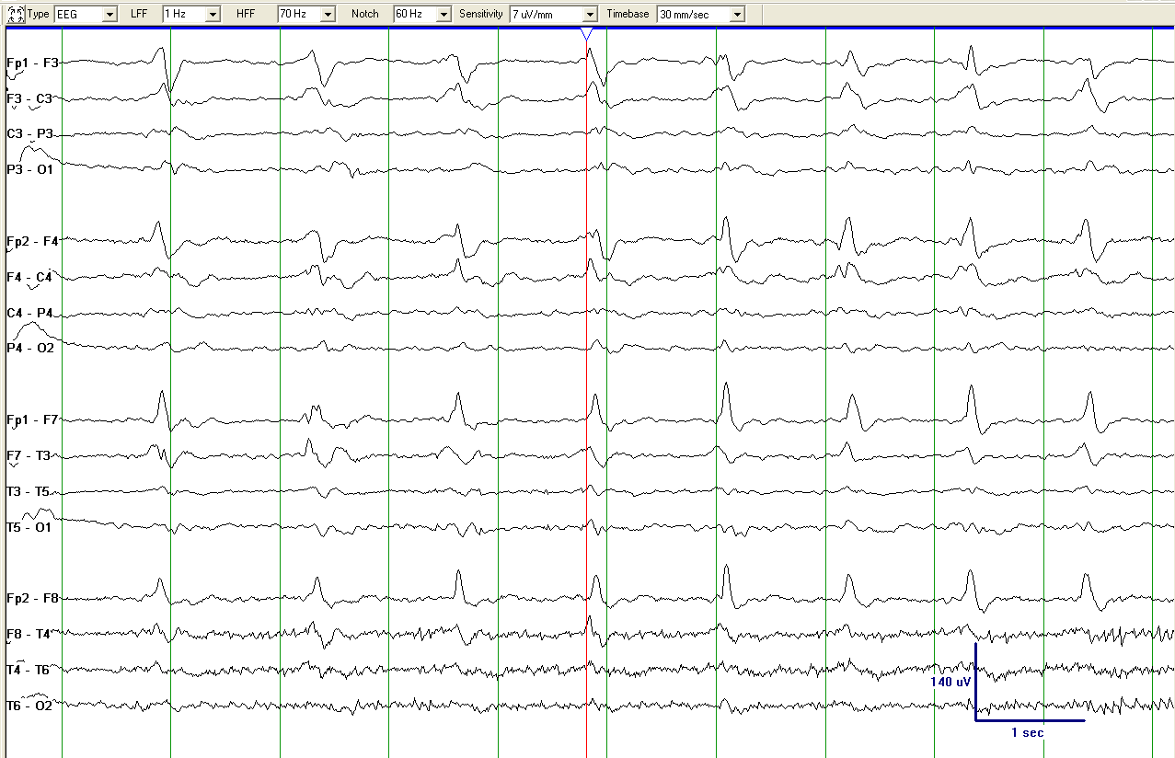
Generalized Periodic Discharges (GPDs)

Slide 17
Generalized Periodic Discharges (GPDs)

Slide 18
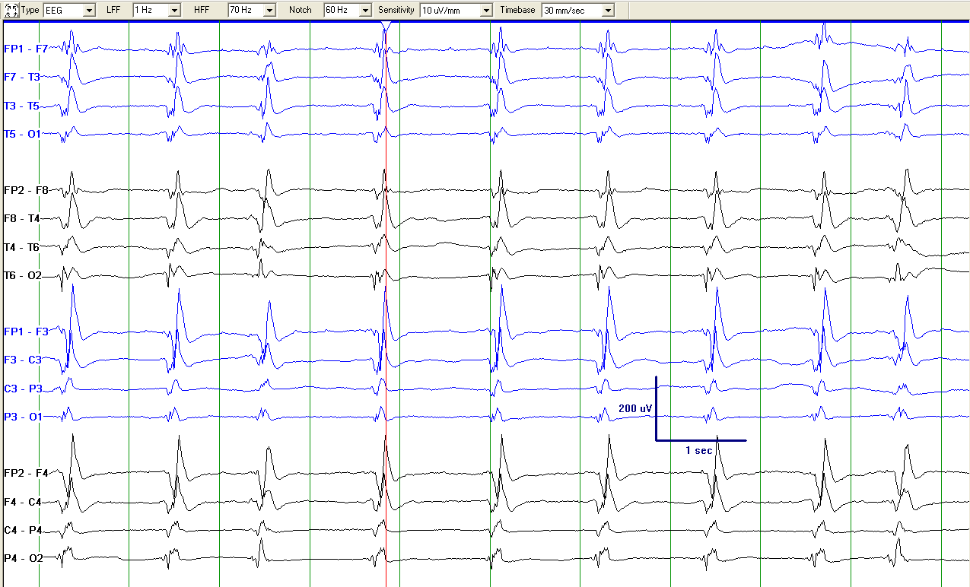
Generalized Periodic Discharges (GPDs)

Slide 19
Generalized Periodic Discharges (GPDs)

Slide 20
Generalized Periodic Discharges (GPDs)

Slide 21
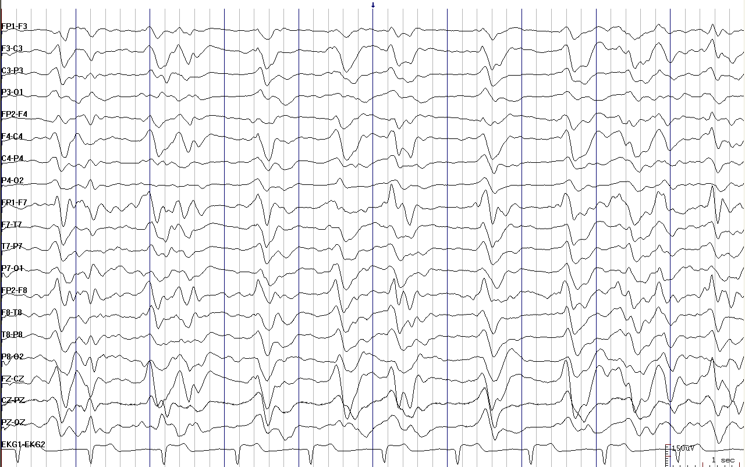
Generalized Periodic Discharges (GPDs)

Slide 22
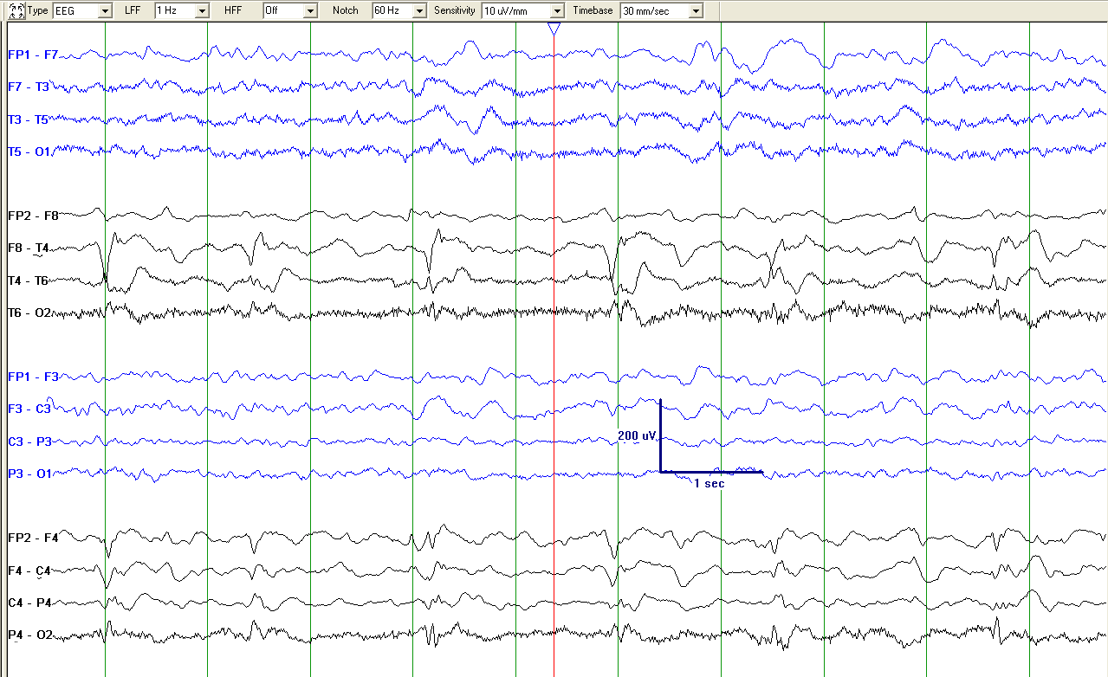
Lateralized Periodic Discharges (LPDs), unilateral

Slide 23
Lateralized Periodic Discharges (LPDs), bilateral asymmetric

Slide 24
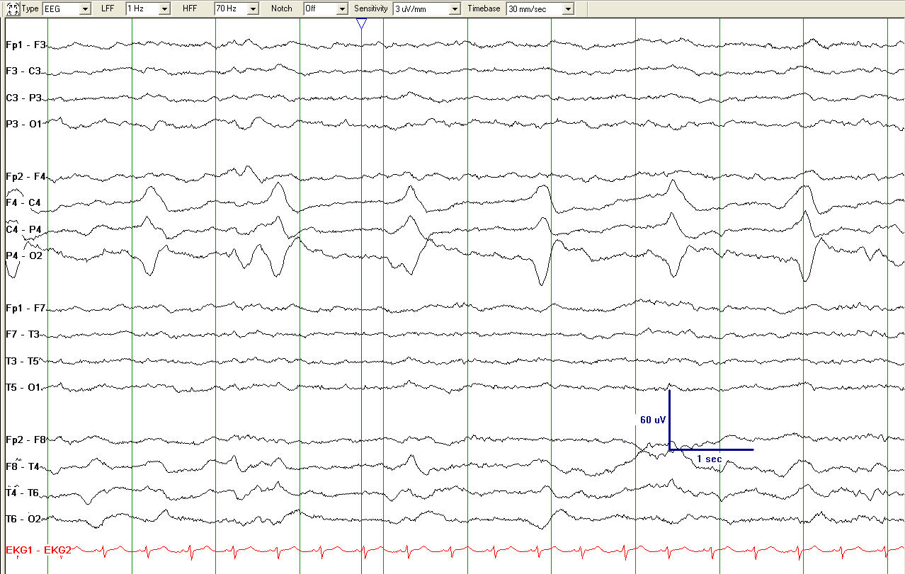
Lateralized Periodic Discharges (LPDs), unilateral

Slide 25
Lateralized Periodic Discharges (LPDs)

Slide 26
Lateralized Periodic Discharges (LPDs); bilateral asymmetric

Slide 27
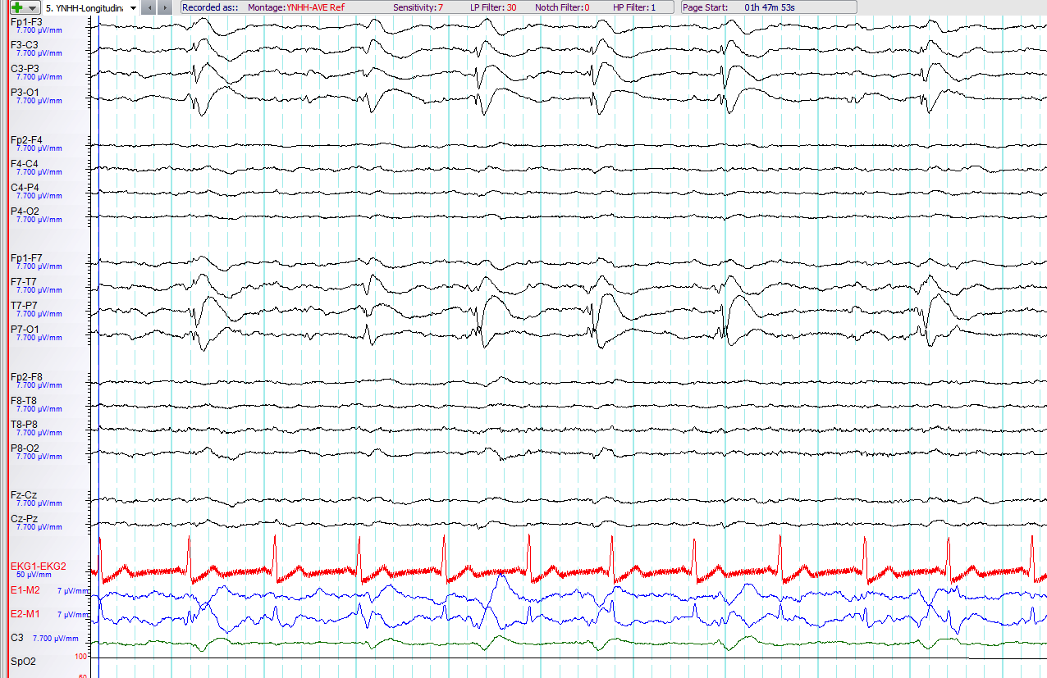
Lateralized Periodic Discharges (LPDs); despite their spike-and-wave morphology, these are PDs as there is a clear interdischarge interval.

Slide 28
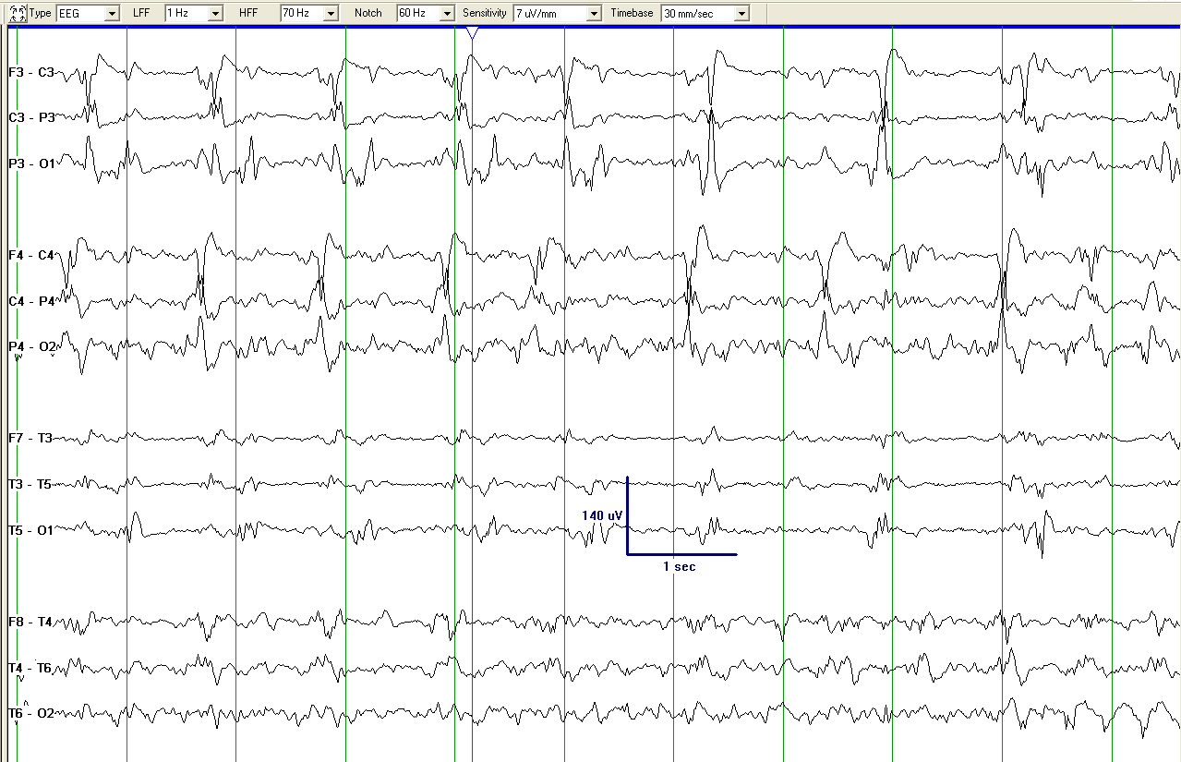
Bilateral Independent Periodic Discharges (BIPDs), bilateral symmetric

Slide 29
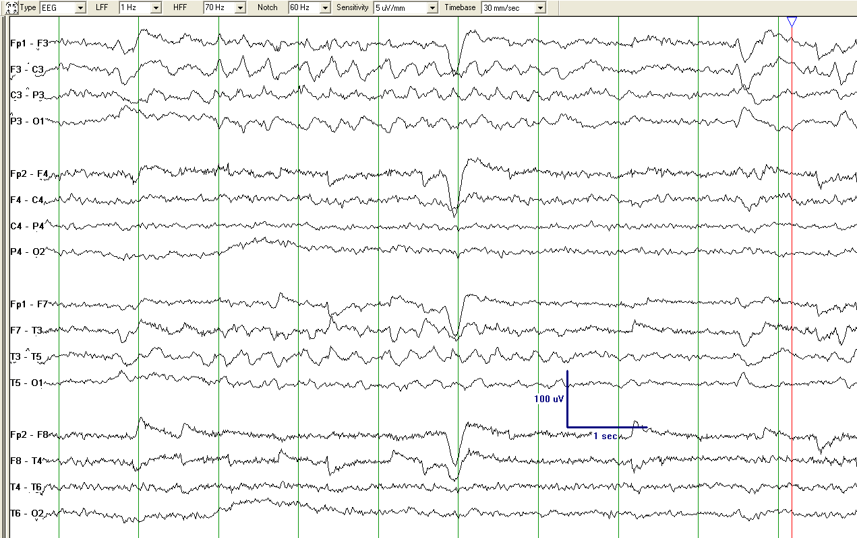
Lateralized Rhythmic Delta Activity (LRDA)
(LRDA +S, as RDA is sharply contoured; see slide 53)

Slide 30
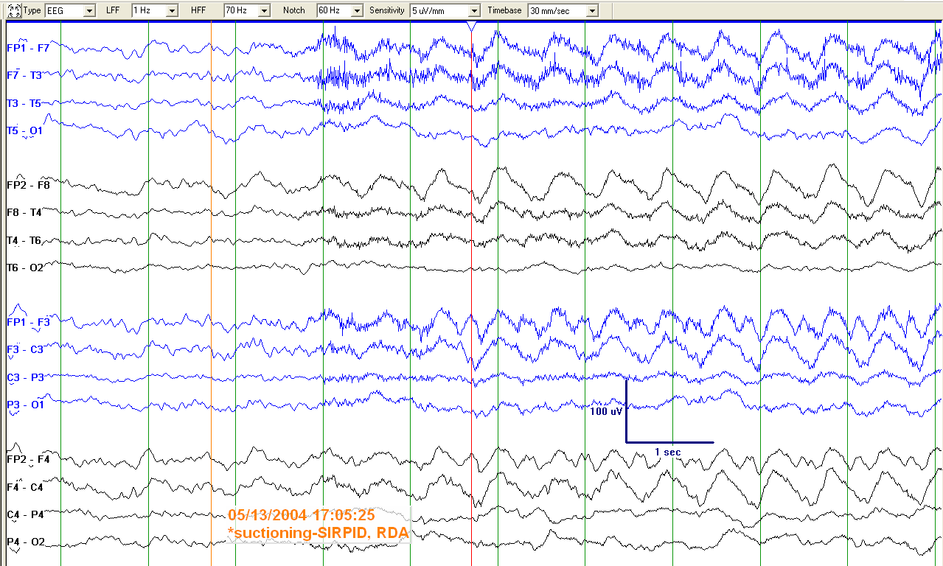
Generalized Rhythmic Delta Activity (GRDA), frontally predominant
(SI-GRDA since stimulus-induced; see slide 48)

Slide 31
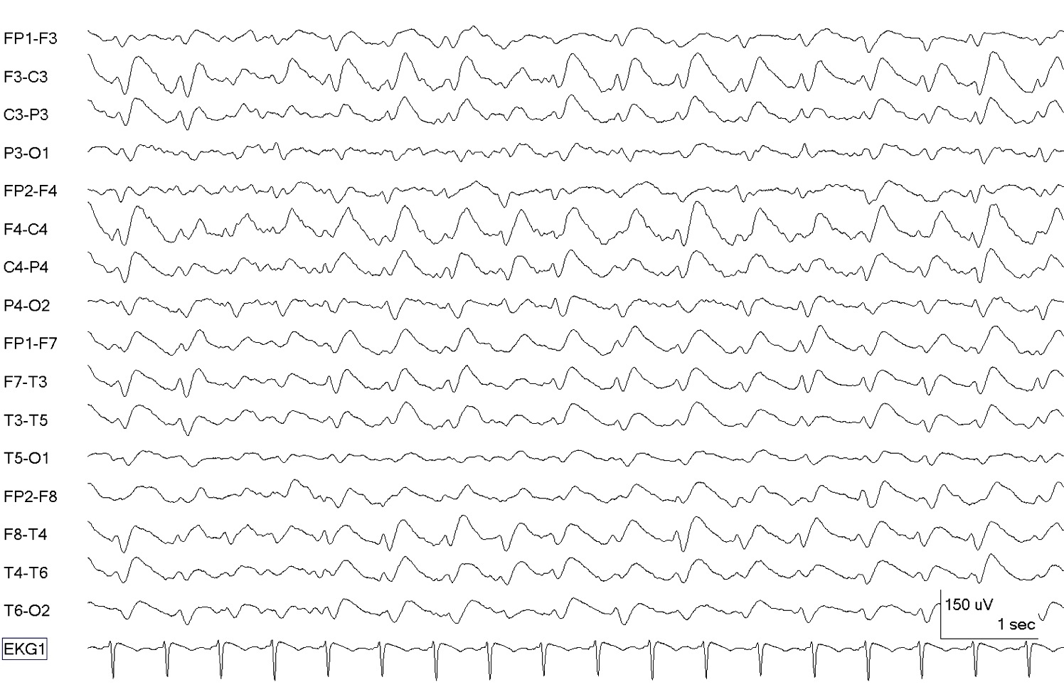
GSW (Generalized sharp-and-wave)

Slide 32
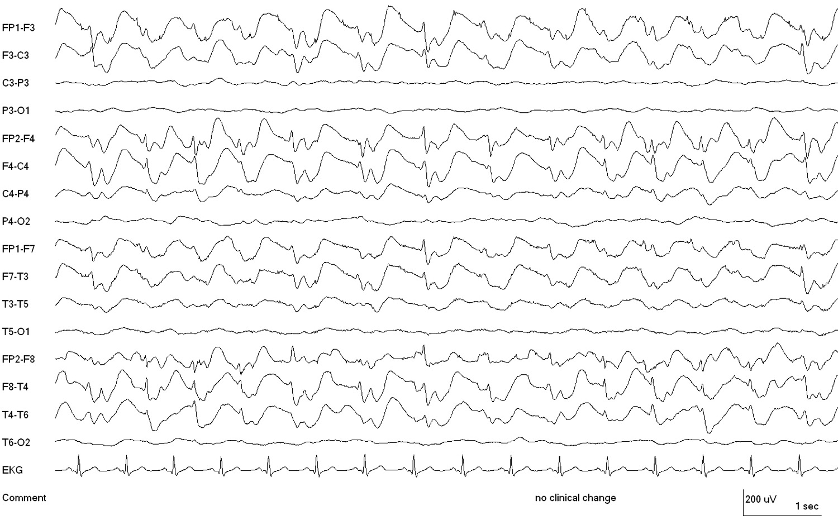
GSW (Generalized polysharp-and-wave). The slow wave is consistently preceded by one or two sharp waves; therefore, GSW is preferred over RDA+S (see slide 53). Also, there is no interdischarge interval; therefore, this does not qualify as GPDs.

Slide 33
Modifiers: Prevalence
Specify:
Approximate percent of record/epoch, using the following divisions, or consistently use the suggested equivalent clinical terms:
    >90% “Continuous”
    50-89% “Abundant”
    10-49% “Frequent”
    1-9% of “Occasional”
    <1% of “Rare”

Slide 34
Modifiers, cont’d: Duration
Specify for each pattern the typical duration of pattern (if not continuous) using the following divisions or suggested equivalent clinical terms.
    >1 hour “Very long”
    5-59 min “Long”
    1-4.9 min “Intermediate”
    10-59 sec “Brief”
    <10 sec “Very brief”
Record total duration (over whole record or 24 hours (“daily pattern duration”; see slide 74) and longest continuous duration.

Slide 35
Modifiers, cont’d: Frequency
Specify for each pattern:
Rate (typical & range) to the nearest 0.5/s division :
<0.5/s, 0.5/s, 1/s, 1.5/s, 2/s, 2.5/s, 3/s, 3.5/s, or >4/s.
e.g., 1/s (typical) and 0.5-2/s (range)

Slide 36
Modifiers, cont’d: Phases
Number of baseline crossings of the typical discharge (in longitudinal bipolar and in the channel in which it is most readily appreciated).
Applies to PDs and the entire spike-and-wave or sharp-and-wave complex of SW (includes the slow wave).
Categorize as 1, 2, 3 or >3.
Applies to PDs and SW, not to RDA.

Slide 37
Modifiers, cont’d: Sharpness
Specify for predominant phase (phase with greatest amplitude) and sharpest phase (if different).
Applies only to PDs and SW, not RDA.
If SW, specify for the spike/sharp wave only. For both phases, describe the typical discharge.
Categorize as one of the following:
  Spiky (duration of phase [measured at EEG baseline] <70 ms)
  Sharp (duration of phase component 70-200 ms)
  Sharply contoured (having a sharp inflection at its peak or trough, or a steep upslope or downslope (such as saw-tooth morphology), but the duration of the wave at the baseline is >200ms and thus does not qualify as sharp or spiky)
  Blunt
Notes:
Definition of Sharply contoured

Slide 38
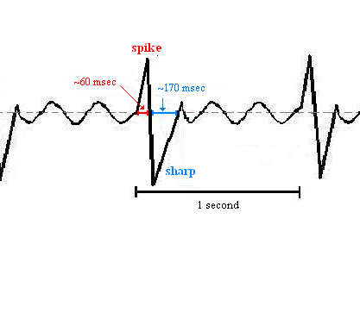
Sharpness
Spiky
Sharp
Sharp
Predominant phase (greatest amplitude): sharp (70-200 ms)
Sharpest phase: spiky (<70 ms)

Slide 39
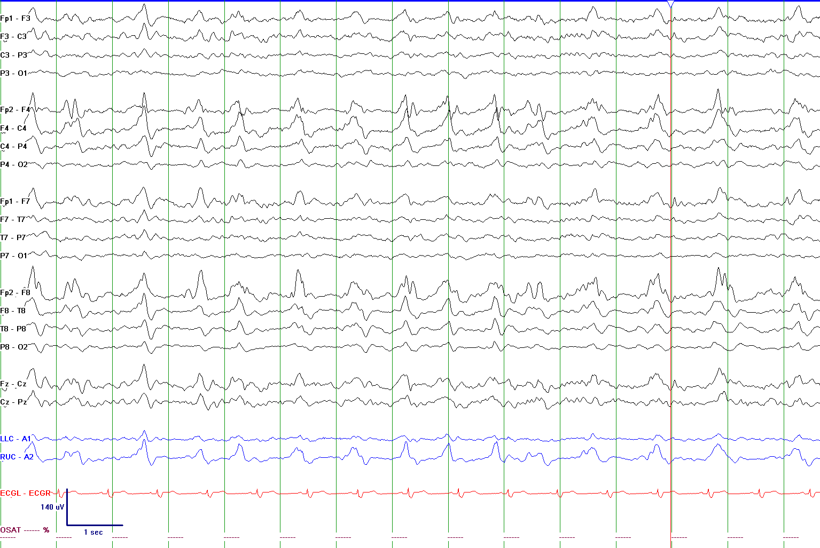
Sharply contoured LPDs (> 200 ms); NOT LPDs+S, since the “+S” modifier for sharply contoured only applies to RDA, not to PDs.
(see slide 53)

Slide 40
Sharply contoured LPDs (> 200 ms); NOT LPDs+S, since the “+S” modifier for sharply contoured only applies to RDA, not to PDs.
(see slide 53)

Slide 41
Sharply contoured GPDs (> 200 ms); NOT LPDs+S, since the “+S” modifier for sharply contoured only applies to RDA, not to PDs.
(see slide 53)

Slide 42
Modifiers, cont’d: Amplitude
Absolute amplitude:
  Typical amplitude measured in standard longitudinal bipolar 10-20 recording in the channel where the pattern is most apparent.
    For PDs, this refers to the highest amplitude component.
    For SW, this refers to the spike/sharp wave.
  Measure peak to trough (i.e. positive to negative peak; not peak to baseline).
  Specify for RDA as well.
  Categorize as:
    <20 uV “very low”
    20-49 uV “low”
    50-199 uV “medium”
    >200 uV “high”

Slide 43
Modifiers, cont’d: Amplitude
Relative amplitude:
For PDs only (require 2 amplitudes: absolute & relative).
Typical ratio of amplitudes of:
  highest amplitude component
  to
  background between discharges (in same channel and montage)
Categorize as <2 or >2.

Slide 44
Amplitude
Absolute amplitude= A ; measured from peak to through
Relative amplitude = A/A_{b}; A_{b} is amplitude of the typical background between discharges (i.e., does not include sporadic waves of higher amplitude; see slide 78)

Slide 45
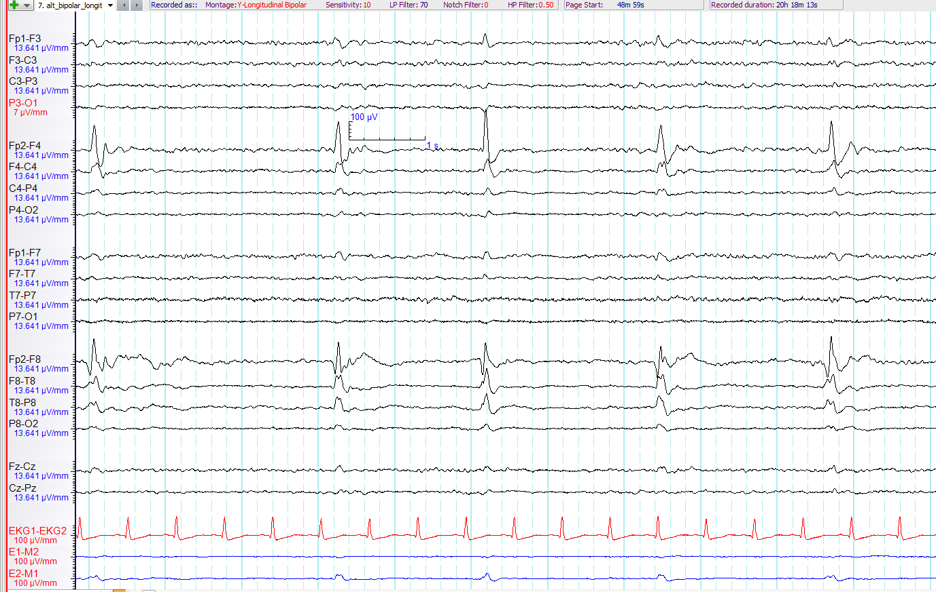
Sharp LPDs with high absolute amplitude (>200µV) and relative amplitude >2

Slide 46
Modifiers, cont’d: Polarity
Specify
For the predominant phase (phase with the greatest amplitude) only.
Describe the typical discharge.
Applies only to PDs and spike/sharp component of SW, not to RDA.
Determined in referential montage.
Categorize as:
  Positive
  Negative
  Dipole, horizontal/tangential
  Unclear

Slide 47
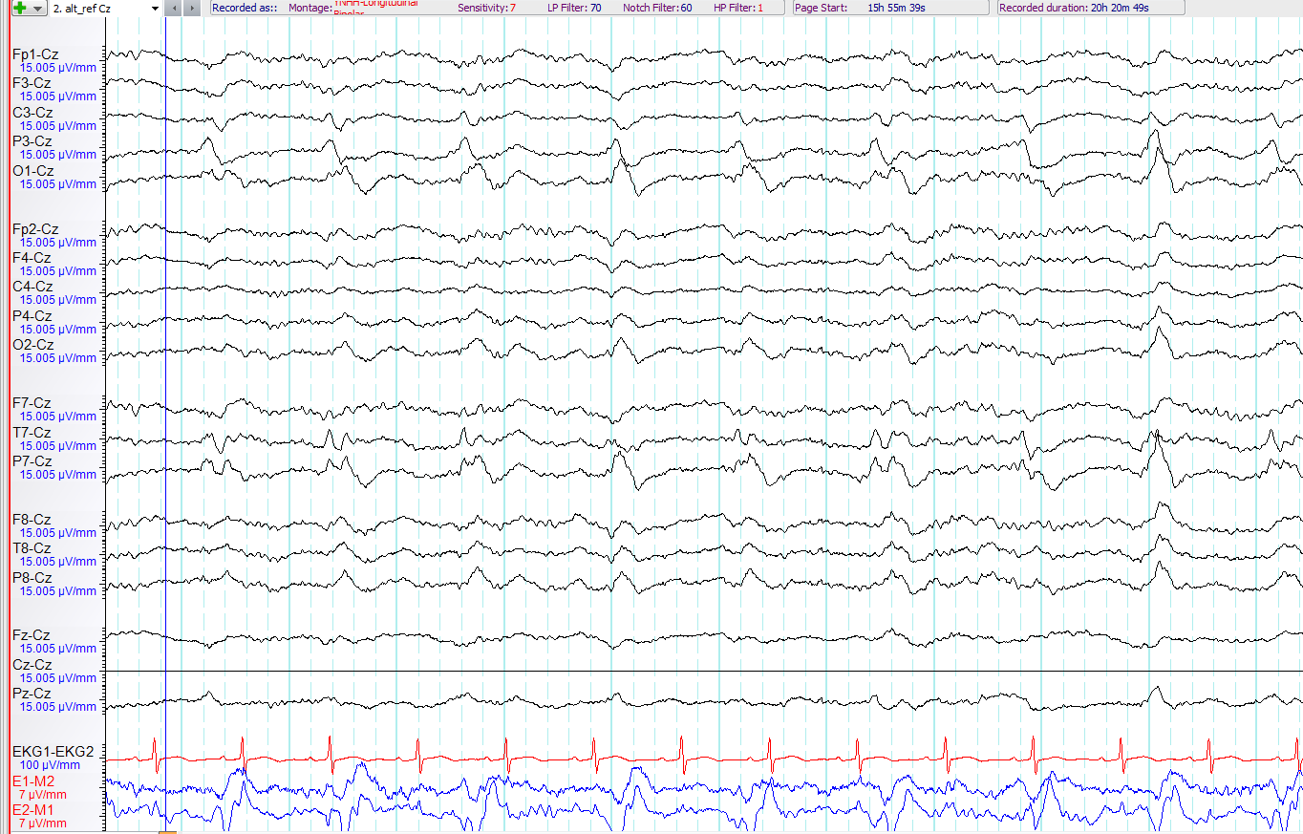
Sharply contoured LPDs with negative polarity

Slide 48
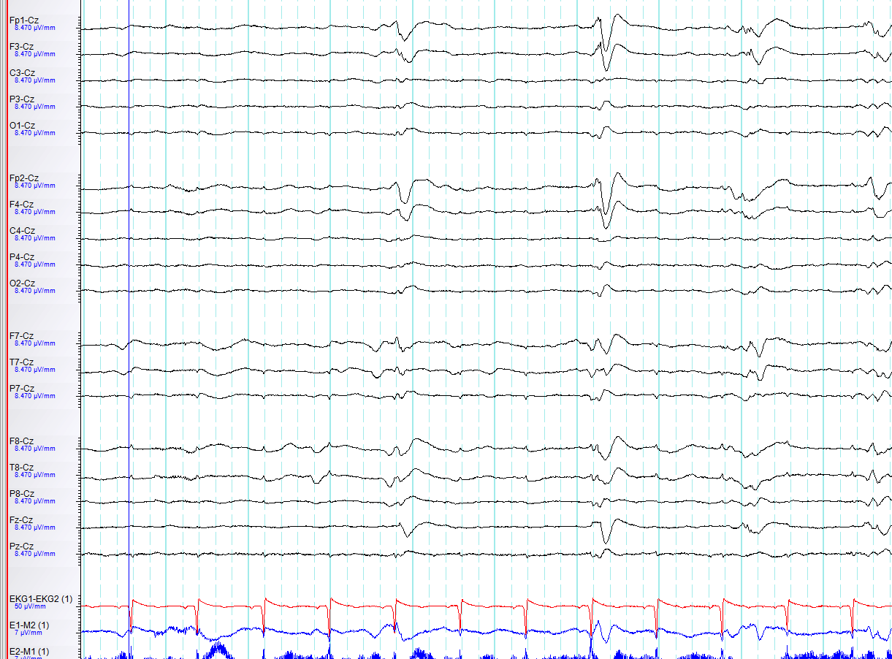
GPDs with positive polarity

Slide 49
Modifiers, cont’d:
Stimulus-Induced (SI)
Repetitively and reproducibly brought about by an alerting stimulus, with or without clinical alerting (may also occur without apparent stimulus--i.e. does not disqualify pattern as SI).
If never clearly stimulus induced, report as spontaneous.
If unknown, unclear or untested, report as unknown.
Specify type of stimulus (auditory, light tactile, patient care and other non-noxious stimulations, suction, sternal rub, nostril tickle or other noxious stimulations).

Slide 50
Modifiers, cont’d:
Evolving or Fluctuating
Both refer to changes in one of the following
  Frequency,
  Location,
  Morphology.
If neither term applies, report as static.

Slide 51
Modifiers, cont’d: Evolving
At least 2 unequivocal, sequential changes in frequency, morphology or location defined as follows:
Frequency: ≥2 consecutive increases or decreases of ≥0.5/s, (e.g. 2 → 2.5 to 3/s, or 3 → 2 to 1.5/s;
Morphology: ≥2 consecutive changes to a novel morphology;
Location : sequentially spreading into/out of ≥2 two different standard 10-20 electrode locations.
To qualify as evolution in frequency or location, each change must persist ≥3 cycles (e.g. 1/s for 3 seconds, or 3/s for 1 second). Thus, the following pattern would qualify as evolving: 3/s for > 1 second, then 2/s for > 1.5 seconds (the first change), then 1.5/s for > 2 seconds (the 2nd change).
    To qualify as evolution in morphology, each different morphology or each morphology plus its transitional forms must last at least 3 cycles. Thus the following examples would both qualify as evolving in morphology:
    - spiky 4-phase PDs for 3 cycles then sharp 2-3 phase PDs for 3 cycles then blunt diphasic PDs for 3 cycles
    - 1 blunt triphasic PD then 2 blunt biphasic PDs then 2 sharply contoured biphasic PDs then 2 sharp biphasic PDs then 3 sharp monophasic PDs.
The pattern must not remains unchanged in frequency, morphology or location for more than 5 minutes. Thus, this pattern would not qualify as evolving: 3/s for 1 min → 2/s for 7 min → 1.5/s for 2 min
Notes:
Fixed definition of location

Slide 52
Modifiers, cont’d: Fluctuating
At least 3 changes, <1 min apart, in:
  Frequency (by ≥0.5/s),
  Morphology, or
  Location (by ≥1 standard inter-electrode distance),
  BUT not qualifying as evolving.
Includes patterns alternating from 1 → 1.5 → 1 → 1.5 Hz; spreading in and out of a single electrode repeatedly; or alternating between 2 morphologies repeatedly.
Would not qualify as fluctuating:
2/s for 30s → 1.5/s for 30s → 2/s for 3min → 1.5/s for 30s → 2/s for 5 min. (Changes are too far apart, i.e. >1 minute).
Would qualify as fluctuating:
2/s for 10 s → 2.5/s for 30s → 2/s for 5s → 2.5/s for 5s.

Slide 53
Modifiers, cont’d:
Evolving and fluctuating
NOTE 1: Change in amplitude or sharpness alone would not qualify as evolving or fluctuating.
NOTE 2: For databasing, if evolving or fluctuating, specify min, max, and typical frequency (under the frequency modifier; see slide 34). For non-generalized patterns, specify degree of spread (none, unilateral, bilateral).

Slide 54
Modifiers, cont’d: Plus
Additional feature which renders the patter more ictal-appearing than the same pattern without the plus:
How to specify:
  +F superimposed fast activity (theta or faster; for PDs or RDA)
  +R superimposed rhythmic or quasi rhythmic delta activity (for PDs only)
  +S “frequent” superimposed sharp waves/spikes (frequent = >1/10s but not periodic and not SW), or sharply contoured (for RDA only)
  If both subtypes apply, PDs can have “+FR” and RDA can have “+FS”.
  Does not apply to SW.
  If absent, database as “no plus”.

Slide 55
Modifiers contd…
PLUS (“+”):
  NOTE 1: Re: Bilateral “+” vs. unilateral: If a pattern is bilateral and qualifies as plus on one side, but not on the other, the overall main term should include the plus (even though one side does not warrant a plus).
    Example: Bilateral independent periodic discharges with fast activity superimposed in one hemisphere only (PD on one side, and PD+F on the other) would qualify for BIPDs+F. Similarly, generalized rhythmic delta activity with superimposed spikes in one hemisphere only (RDA on one side and RDA+S on the other) would qualify for GRDA+S
  NOTE 2: Re: +F: If a pattern qualifying as RDA or PDs has superimposed continuous fast activity (theta or faster), this should be coded as +F ONLY if the fast activity is not present in the background activity when the RDA or PDs is not present. In other words, if the superimposed fast activity is part of the RDA or PD pattern and not simply part of the background activity.

Slide 56
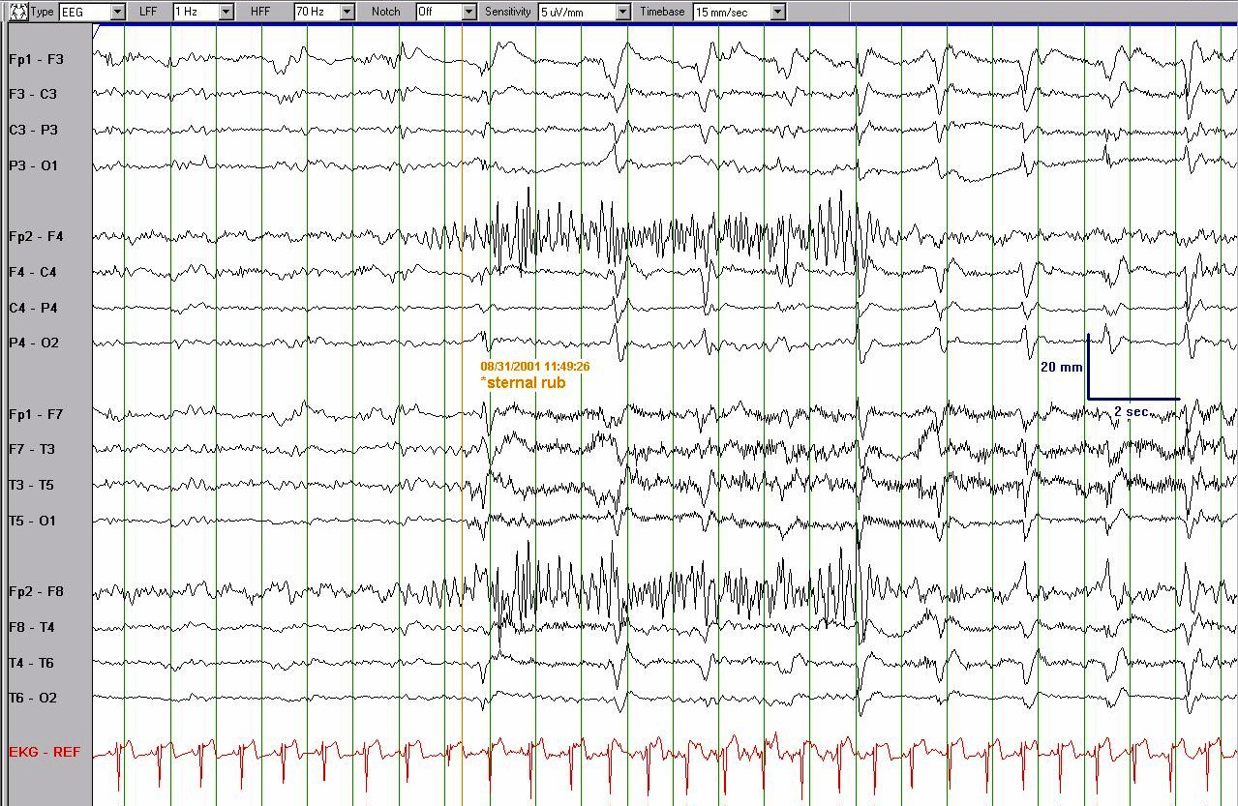
SI-GPDs

Slide 57
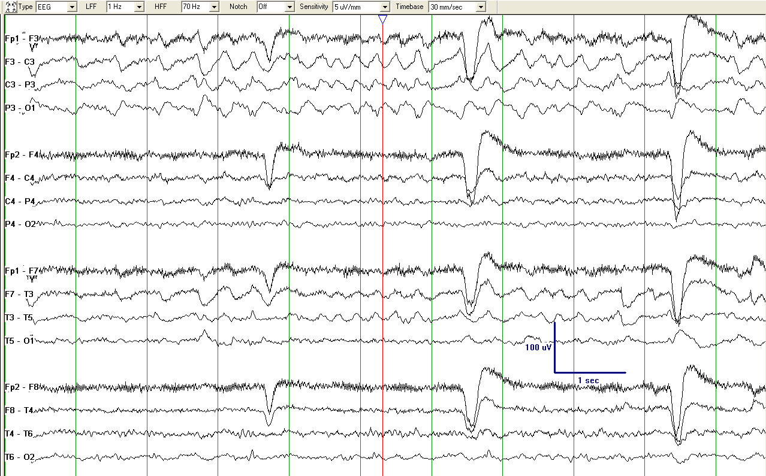
Evolving LRDA+S. (Note sequential changes in frequency from 1.5Hz to 3Hz. Each change lasts > 3 cycles)

Slide 58
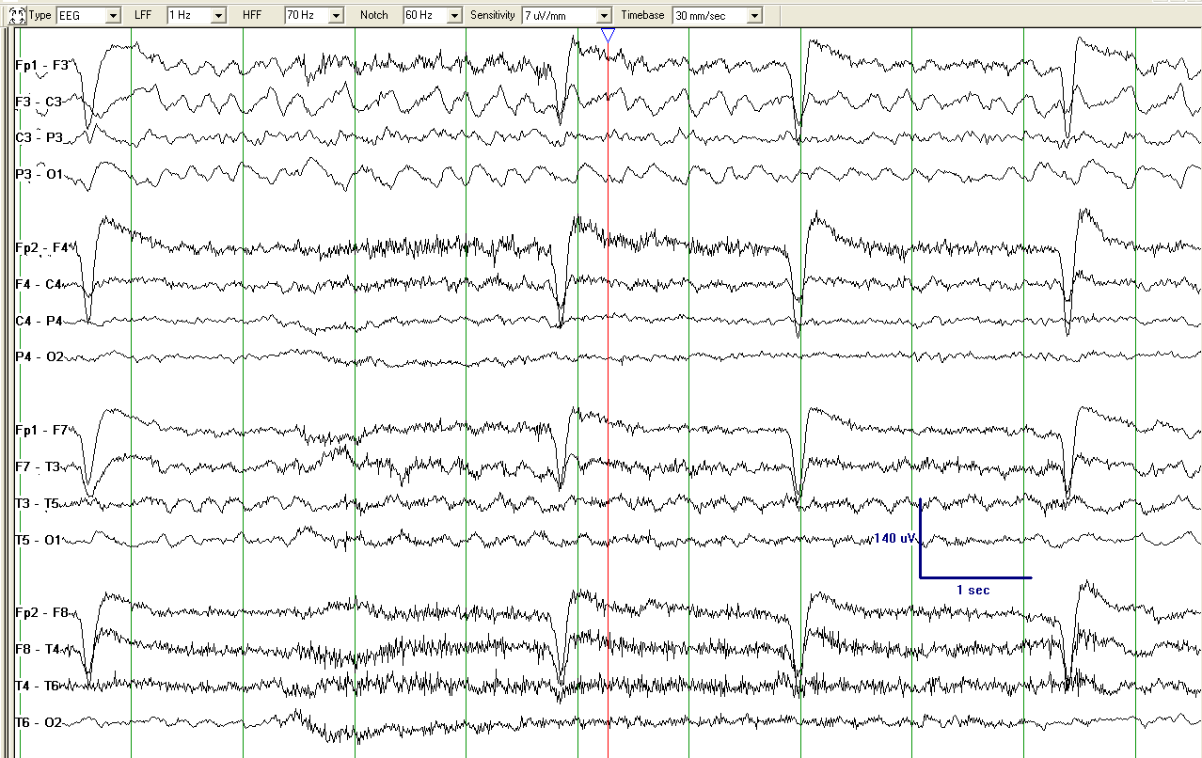
Fluctuating LRDA+S. (As the pattern alternates at least three times between two different frequencies and each change lasts at least 3 cycles, it qualifies for fluctuating )

Slide 59
LRDA +S

Slide 60
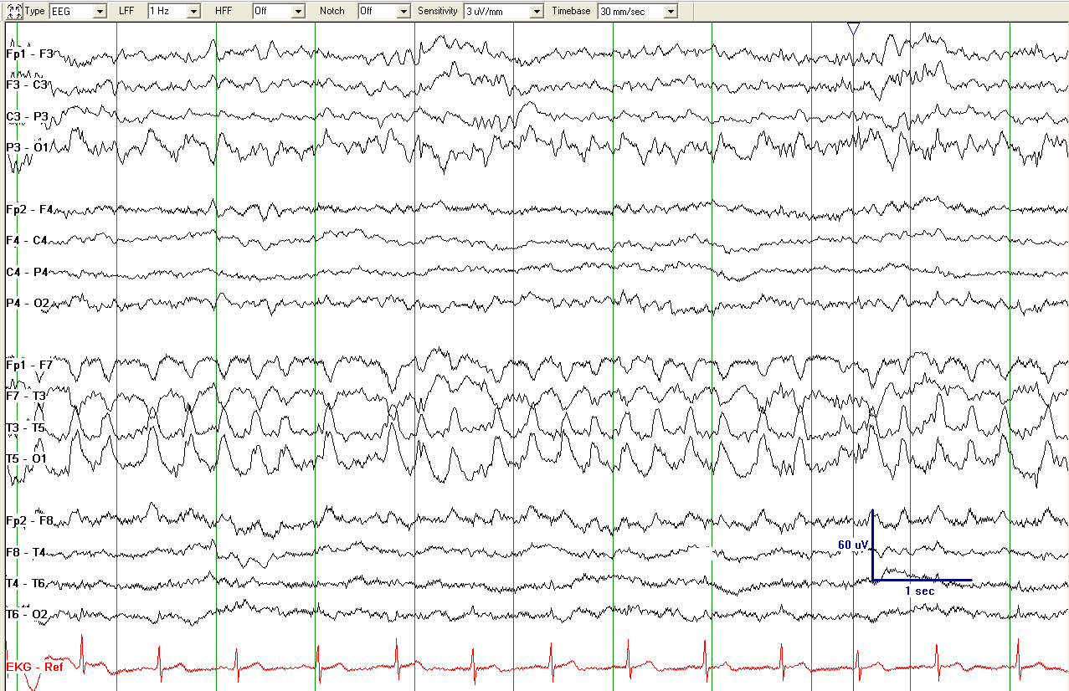
LRDA +S* (being less than 4/s, this pattern is included in this nomenclature)
*this pattern would be classified as “+FS” if the low voltage fast activity seen within the LRDA was not present in the background activity at a time without the LRDA.

Slide 61
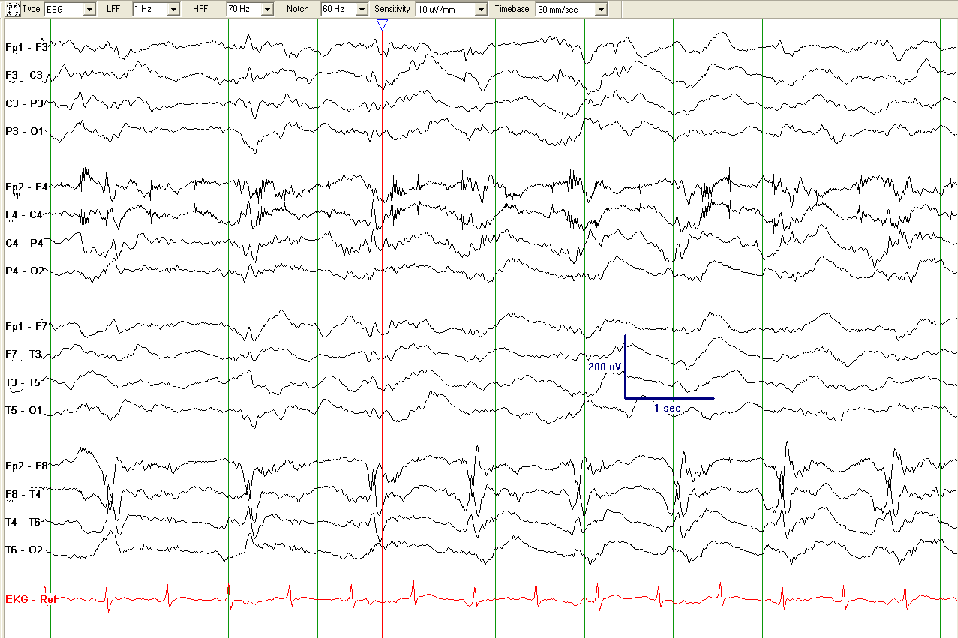
Spiky LPDs+F

Slide 62
Sharp LPDs. (Reminder note: the “+S” modifier applies only to RDA)

Slide 63
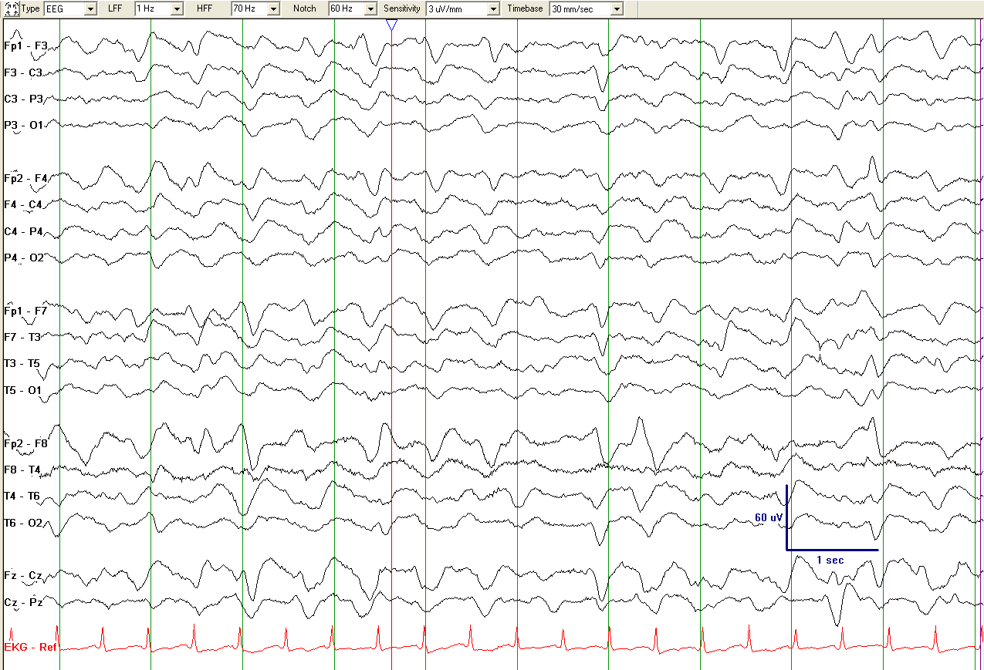
GRDA+S (in this case “+S” refers to “sharply contoured”)

Slide 64
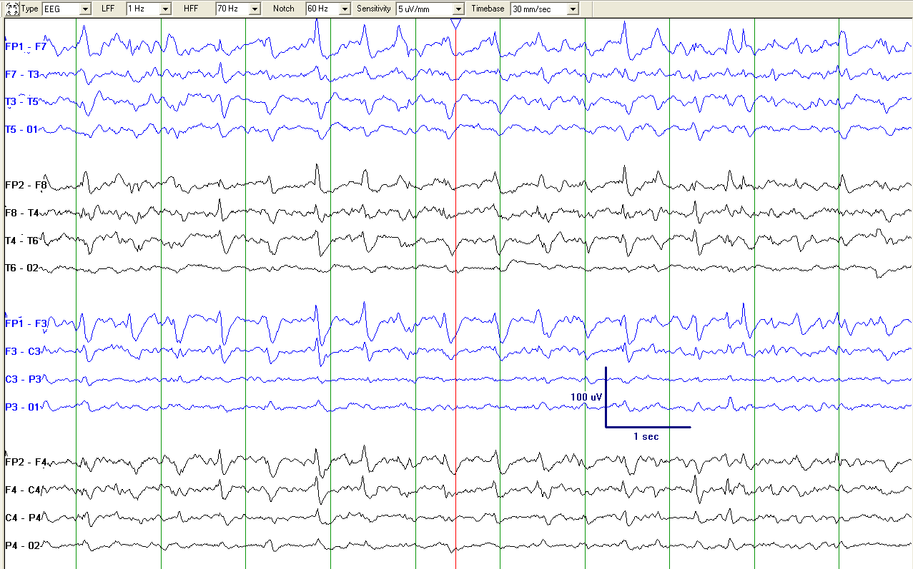
GPDs+R (combination of RDA and PDs; therefore termed PDs+R, not RDA)

Slide 65
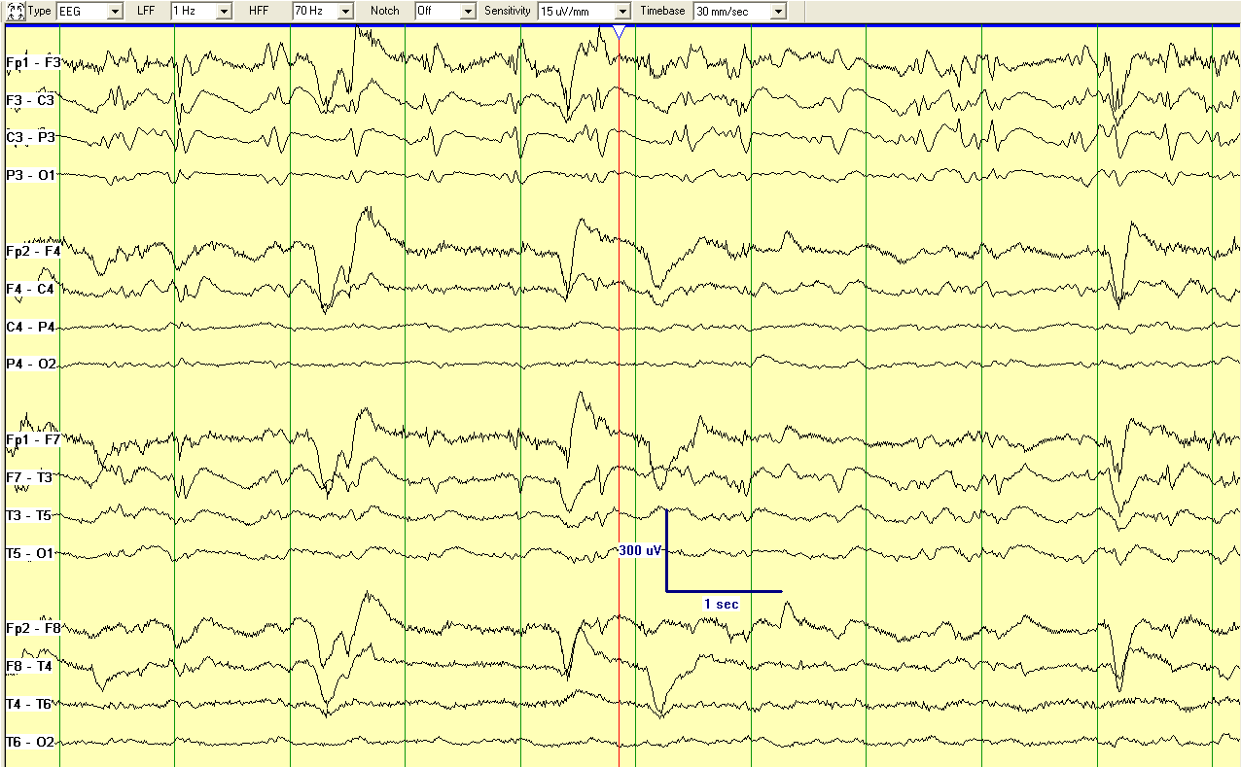
Fluctuating LPDs+FR; as the sharpest and the most prominent components of this pattern differ, it would qualify for BOTH spiky AND sharp (see slide 36)

Slide 66
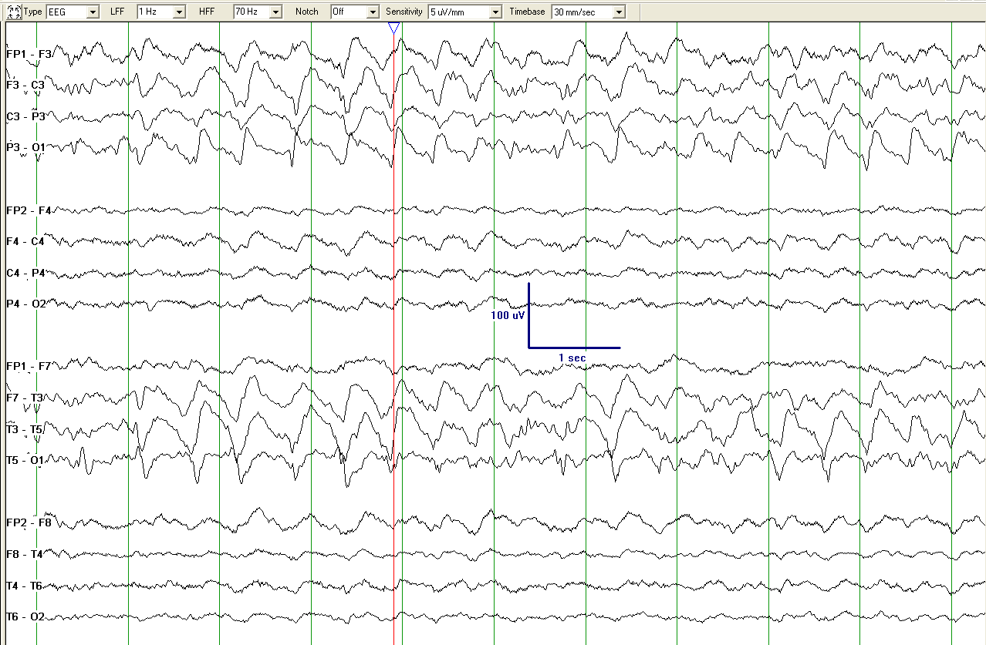
Fluctuating LRDA+S. Superimposed fast activity could qualify for +F if it were present only with RDA (i.e. absent from background), which is not possible to determine on this page.

Slide 67
Minor modifiers
(all except “Quasi-” are required for database studies; record presence or absence of each):
Quasi-: Defined as: Cycle length (period) varying by 25-50% from one cycle to the next in >50% of cycle pairs.
Does not qualify if the cycle length varies by >50% (in which case it is not rhythmic at all) or <25% (in which case it is rhythmic, without the “quasi-”) in the majority of cycles.
Use only when using computer-assisted analysis. Modifies rhythmic or periodic patterns, as in quasi-periodic or quasi-rhythmic.
(Quasi preferred over pseudo- or semi-).
When not using computer analysis, quasi-periodic is coded as periodic, and quasi-rhythmic as rhythmic.
Onset:
Sudden (preferred over paroxysmal): Progressing from absent to well-developed in <3s.
Gradual onset : Progressing from absent to well-developed in >3s.

Slide 68
Minor modifiers: Cont’d
(all except “Quasi-” are required for database studies; record presence or absence of each):
Triphasic morphology: Applies to PDs and SW. Either two or three phases, with each phase longer than the previous, and the positive phase of highest amplitude. If three phases, this must be negative-positive-negative in polarity; if two phases, positive-negative. Note that a biphasic waveform may be categorized as “triphasic” by this definition.
Anterior-posterior lag or posterior-anterior lag: Applies if a consistent measureable delay of >100 ms exists from the most anterior derivation to the most posterior derivation in which it is seen ; specify typical delay in msec from anterior to posterior (negative = posterior to anterior lag) in both longitudinal bipolar and in a referential montage, preferably with an ipsilateral ear reference.

Slide 69
III
II
Note on triphasic waves: In the typical appearance of TW, phase II is the most prominent and phases I and III are of similar amplitudes. In some cases, however, phase I may appear blunted or even be absent, resulting in TW with a biphasic morphology (phase II-III only).
Example is from SILVERMAN, D. (1962). Some observations on the EEG in hepatic coma. Electroencephalography and clinical neurophysiology, 14(1), 53–59.

Slide 70
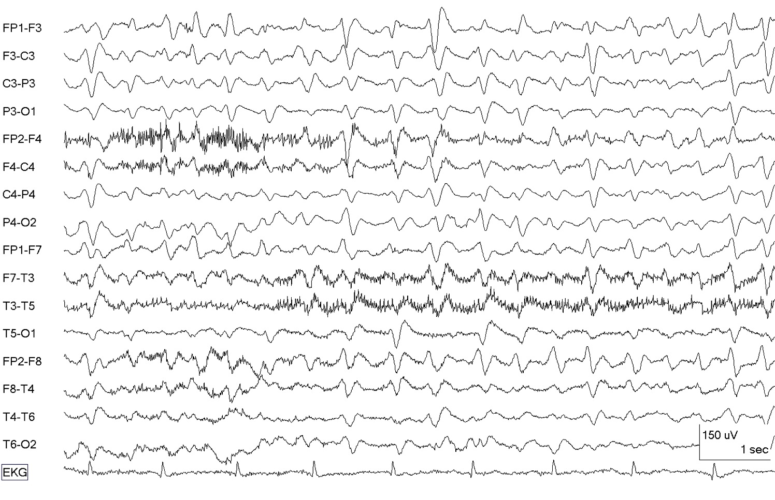
Fluctuating GPDs (with triphasic morphology)

Slide 71
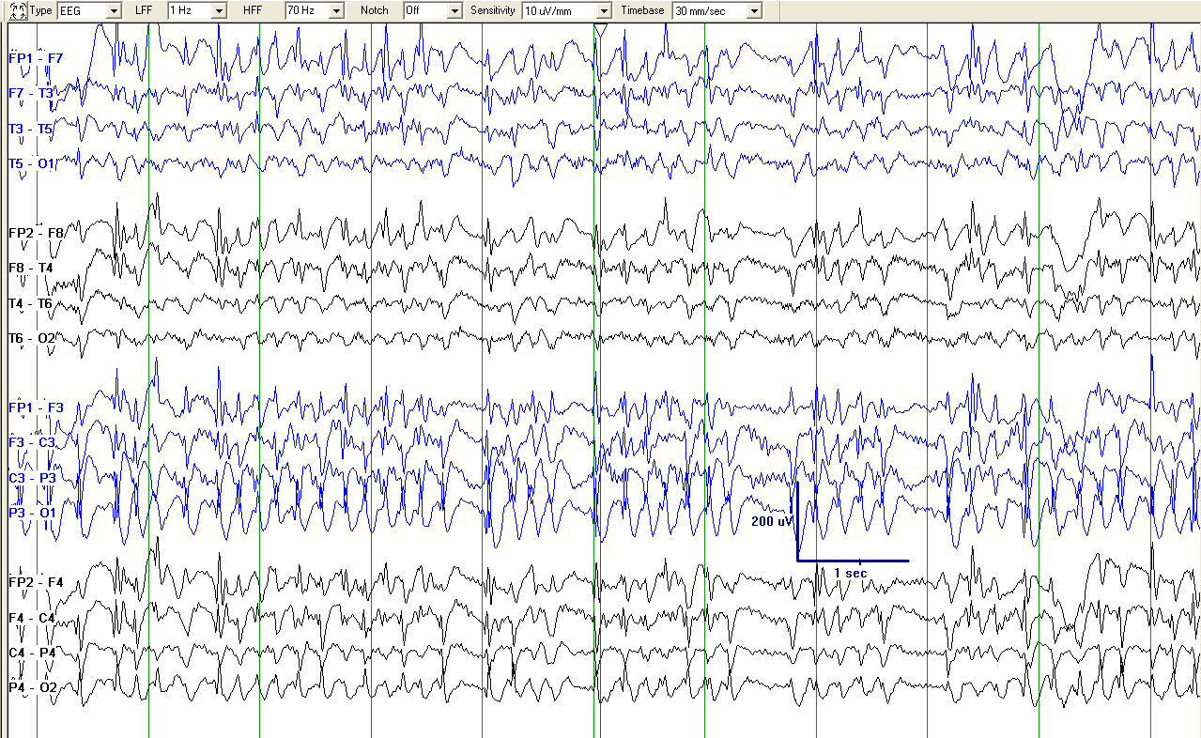
Seizure (NCSE; Since its frequency is more than 4/s, this pattern would not be included in this nomenclature)

Slide 72
Minimal time epochs to be reported/databased separately
First ~30 minutes (equivalent to a “routine” EEG).
Each 24 hour period.
If significant changes occur in the record during this time period, report additional epochs separately as needed.

Slide 73
Moving on…
Next slides specify how to record:
  Sporadic epileptiform discharges
  EEG background (e.g. slowing, posterior dominant rhythm, etc)

Slide 74
Sporadic (non-rhythmic and non-periodic) epileptiform discharges: Frequency
  Use the following standard time divisions or suggested equivalent clinical terms:
  >1 / 10s : (“Abundant”) (average ≥1 / typical EEG page)
>1/min –1/10s: (“Frequent”)
> 1/h -- 1/min (“Occasional”)
<1/h (“Rare”)

Slide 75
N.B. re: Prevalence/Duration/Frequency
Note that there are 4 distinct time-related scales:
  1. Prevalence (continuous, abundant, frequent, occasional, rare): refers to percent of the entire record occupied by a pattern
  2. Duration (very long, long, intermediate, brief, very brief): refers to the typical duration of a single occurrence of the pattern, regardless of whether the pattern occurs rarely or frequently.
  3. Quantification of sporadic (aka “interictal”) epileptiform discharges (abundant, frequent, occasional, rare)

Slide 76
N.B. Other terms for research use
“Daily Pattern Duration” is defined as total duration of a pattern per 24 hours. e.g. if GPDs were present for 33% of the record for 12 hours, then 10% of the record for 12 hours, the Daily GPD Duration would be 4 hours + 1.2 hours = 5.2 hours. Daily Seizure Duration can be calculated similarly: e.g. six 30-second seizures in one day would have a Daily Seizure Duration of 3minutes.
“Daily Pattern Index” is defined as Daily Duration X Mean Frequency (Hz). In the above example, if GPDs were at 1.5 Hz, the Daily GPD Index would be 5.2 h x 1.5 Hz = 7.8 Hz-hours.

Slide 77
N.B. re: Amplitudes
Note that there are multiple ratings for amplitude:
  1. Absolute amplitude of a single discharge within a pattern
    Applies to all patterns (see slide 42)
    Categorize as:
      <20 uV “very low”
      20-49 uV “low”
      50-199 uV “medium”
      >200 uV “high”
  2. Relative amplitude of a single discharge to the interdischarge amplitude during a periodic pattern
    Applies to PDs only (see slide 43)
    Categorize as <2 or >2.
  3. Background amplitude (voltage)
    Applies to EEG background description (see slide 79)
    Categorize as:
      >20µV “normal”
      <20µV but >10µV “low”
      <10µV “suppressed

Slide 78


Slide 79
Background EEG
Symmetry:
  Symmetric
  Mild asymmetry (consistent asymmetry in amplitude on referential recording of <50%, or consistent asymmetry in frequency of 0.5 - 1 Hz )
  Marked asymmetry (>50% amplitude or >1 Hz frequency asymmetry).
Breach effect (note presence, absence, or unclear)
When any of the following features are asymmetric, they should be described separately for each hemisphere.
Posterior dominant “alpha” rhythm: Specify frequency (to the nearest 0.5 Hz) or absence.
Predominant background EEG frequency: Delta, Theta, and/or >Alpha. If 2 or 3 frequency bands are equally prominent, record each one.
Variability: Yes, No, or unknown/unclear/not applicable. The last choice might apply, for example, in a 30 minute awake record.
Reactivity: Change in cerebral EEG activity to stimulation: Yes, No, or Unclear/unknown/not applicable. Appearance of muscle activity does not qualify as reactive. If the only form of reactivity is SI-RDA, SI-PDs , SI-SW or SI-seizures, categorize as “Reactive, SIRPIDs only”.
Voltage:
  Normal
  Low (most or all activity <20 µV in longitudinal bipolar with standard 10-20 electrodes, [measured from peak to trough]), or
  Suppressed (all activity <10 µV). If discontinuous, this refers to the higher amplitude portion.

Slide 80
Background EEG, cont’d.
Anterior-posterior (AP) gradient: Present, absent or reverse.
  An AP gradient is present if at any point in the epoch, there is a clear and persistent (at least 1 continuous minute) anterior to posterior gradient of voltages and frequencies such that lower amplitude, faster frequencies are seen in anterior derivations, and higher amplitude, slower frequencies are seen in posterior derivations
  A reverse AP gradient is defined identically but with a posterior to anterior gradient of voltages and frequencies.
Stage II sleep transients (K-complexes and spindles):
  Normal (K-complexes and spindles both present and normal),
  Present (at least one) but abnormal, or
  Absent (both absent).
Notes:
Added AP gradient

Slide 81
Background EEG, cont’d.
Continuity:
  Continuous
  Nearly Continuous: continuous, but with occasional (<10% of the record) periods of attenuation or suppression. Describe typical duration of attenuation/suppression as above.
    Nearly continuous with attenuation: periods of lower voltage are >10µV but <50% of the background voltage
    Nearly continuous with suppression: periods of lower voltage are <10 µV
    If suppressions/attenuations are stimulus-induced, code as “nearly continuous with SI-attenuation” or “…with SI-suppression”
  Discontinuous: 10-49% of the record consisting of attenuation or suppression, as defined above.
  Burst-attenuation/Burst-suppression: more than 50% of the record consisting of attenuation or suppression, as defined above, with bursts alternating with attenuation or suppression; specify the following:
    Typical duration of bursts and interburst intervals
    Sharpest component of a typical burst using the sharpness categories defined under modifiers
    Presence or absence of Highly Epileptiform Bursts (HEB): Present if multiple epileptiform discharges (traditional definition) are seen within the majority (>50%) of bursts and occur at an average of 1/s or faster; record typical frequency (using categories above) and location (G, L, BI or Mf). Also present if a rhythmic, potentially ictal-appearing pattern occurs at 1/s or faster within the majority (>50%) of bursts; record frequency and location as well
  Suppressed: entirety of the record consisting of suppression (<10 uV, as defined above).
Notes:
Fixed presence of HEB

Slide 82
OLD term NEW term
triphasic waves,
most of record = continuous 2/sec GPDs
[with triphasic morphology can be added]
PLEDs = LPDs
BIPLEDs = BIPDs
GPEDs/PEDs = GPDs
FIRDA = Occasional brief 2/sec GRDA
(if 1-10% of record); (frontally predominant can be added)
PLEDS+ = LPDs+
SIRPIDs w/ focal evolving RDA= SI-Evolving LRDA
Lateralized seizure, = Evolving LRDA
delta frequency
Semirhythmic delta = Quasi-RDA

Slide 83
Summary: Main Terms
Generalized (G); OR
Lateralized (L); OR
Bilateral Independent (BI); OR
Multifocal (Mf)
AND
Periodic Discharges (PDs); OR
Rhythmic Delta Activity (RDA); OR
Spike-and-Wave or Sharp-and-Wave (SW)

Slide 84
Summary: Modifiers
Prevalence
Duration
Frequency
Phases
Sharpness
Amplitude
Polarity
Stimulus-Induced (SI)
Evolving OR Fluctuating
Plus (+)

Slide 85
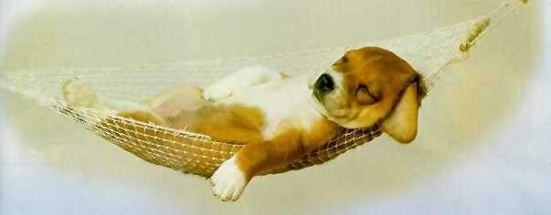
The End!

