Slide 1
ACNS Critical Care EEG Terminology Training Module 2021, Part 1 of 3
Markus Leitinger, MD
Department of Neurology, Christian Doppler University Hospital
Center for Cognitive Neuroscience
Paracelsus Medical University
Salzburg, Austria
Michael W.K. Fong, MBBS
Westmead Comprehensive Epilepsy Unit
Westmead Hospital
University of Sydney
Sydney, Australia
Lawrence J. Hirsch, MD
Comprehensive Epilepsy Center
Department of Neurology
Yale University School of Medicine,
New Haven, CT, USA

Slide 2
Mode of presentation
General remarks:
This module has been designed to provide a self guided introduction to the important components of the ACNS standardized critical care EEG terminology, 2021 version. It focuses on discussing terms that are commonly used or with a high clinical importance. It does not describe all of the major and minor modifiers (although it includes many). For comprehensive details on all feaures of the terminology please refer to the ACNS guideline that can be found at https://www.acns.org/practice/guidelines, under “Continuous EEG Monitoring in Critical Care“, or via the Journal of Clinical Neurophysiology https://journals.lww.com/clinicalneurophys/Fulltext/2021/01000/American_Clinical_Neurophysiology_Society_s.1.aspx

Slide 3
Contents for Part 1 of 3
Sequence of topics (follows the full guideline):
A. EEG BACKGROUND
B. SPORADIC EPILEPTIFORM DISCHARGES
C. RHYTHMIC AND PERIODIC PATTERNS (RPPs)
D. ELECTROGRAPHIC AND ELECTROCLINICAL SEIZURES [NEW, 2021]
E. BRIEF POTENTIALLY ICTAL RHYTHMIC DISCHARGES (BIRDs) [NEW, 2021]
F. ICTAL-INTERICTAL CONTINUUM (IIC) [NEW, 2021]
Sequence of slides for each topic:
1. Introductory text plus diagram
2. EEG example alone with question at the bottom
3. EEG with explanatory annotations
4. Summary slide

Slide 4
A. EEG Background

Slide 5
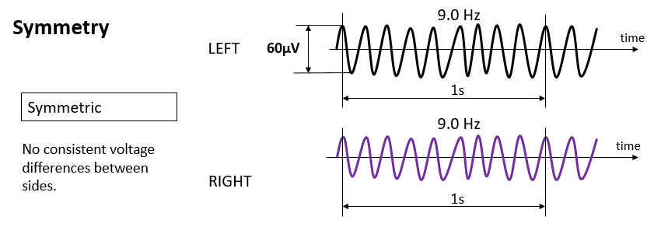
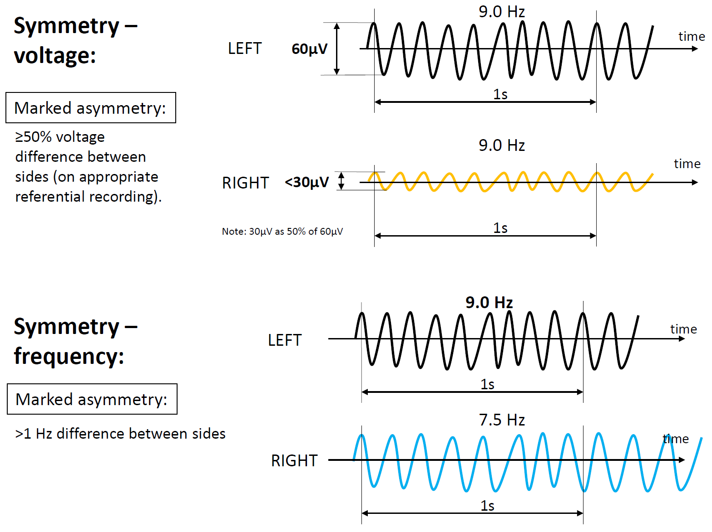
EEG BACKGROUND
1. Symmetry
a. Symmetric.
b. Mild asymmetry (consistent asymmetry in voltage on an appropriate referential recording of <50% or consistent asymmetry in frequency of 0.5 to 1 Hz).
c. Marked asymmetry (≥50% voltage or >1 Hz frequency asymmetry).
2. Predominant Background Frequency When Most Awake or After Stimulation: Beta (>13 Hz), Alpha, Theta, Delta.
NOTE: If two or three frequency bands are equally prominent, report each one.
3. Posterior Dominant (“Alpha”) Rhythm (must be demonstrated to attenuate with eye opening; wait >1 second after eye closure to determine frequency
to avoid “alpha squeak”): Present: Specify frequency to the nearest 0.5 Hz, Absent, Unclear.
No consistent voltage differences between sides.

Slide 6
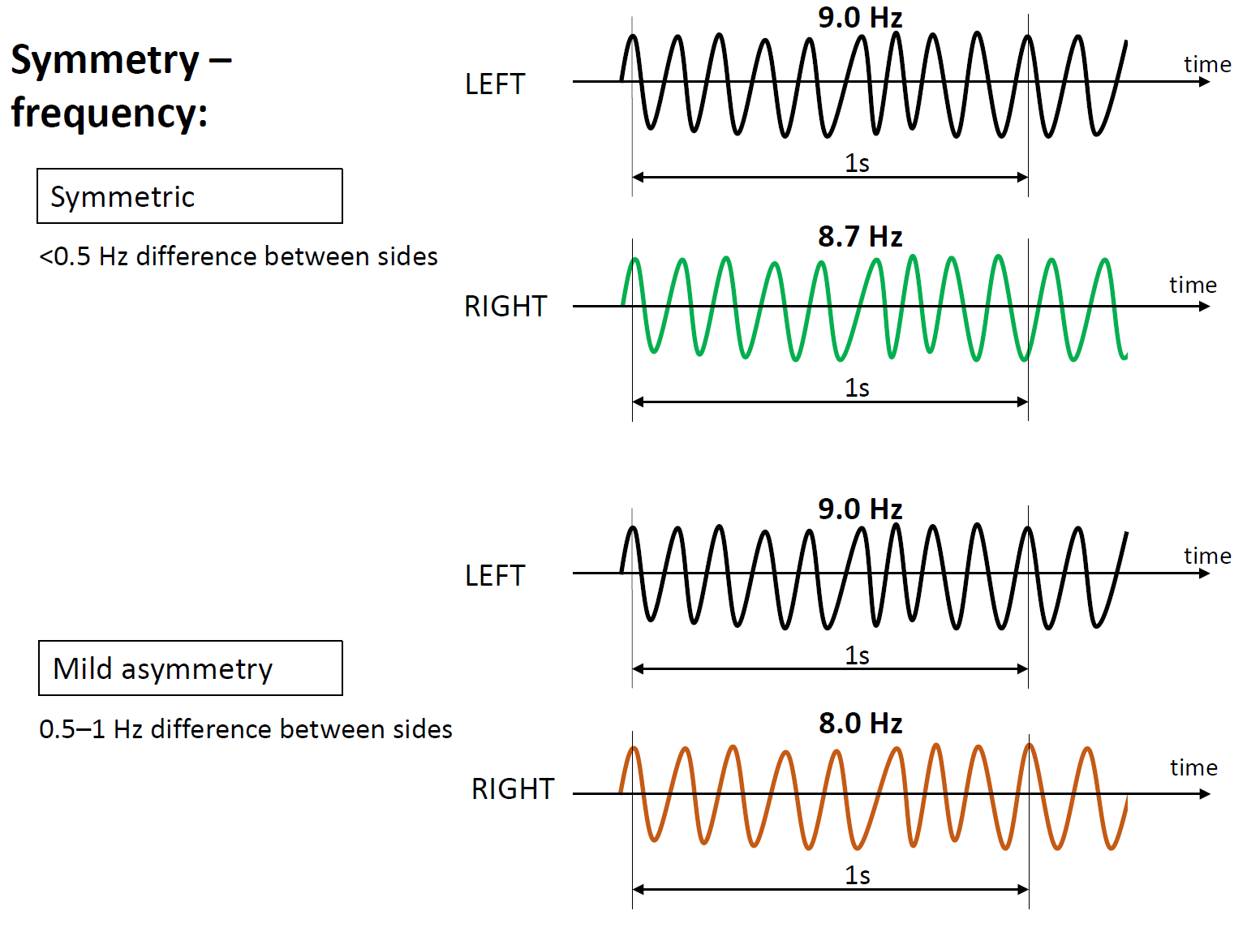
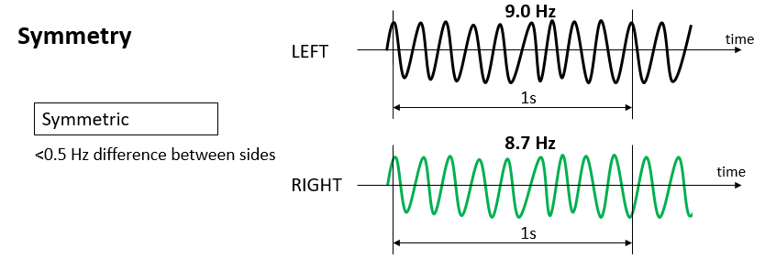
EEG BACKGROUND
No consistent frequency differences between sides.

Slide 7
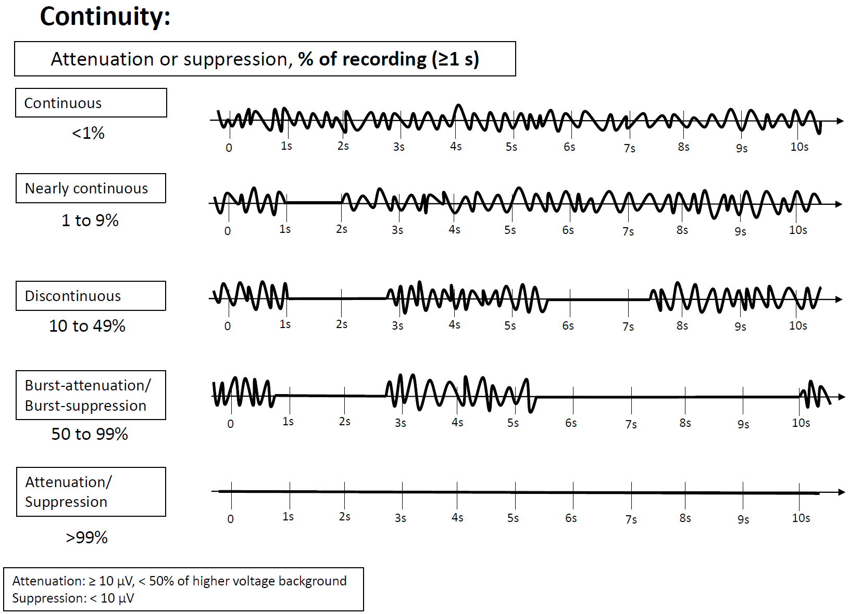
EEG BACKGROUND
4. Continuity
a. Continuous
b. Nearly Continuous: continuous, but with occasional (1–9% of the record) periods of attenuation or suppression lasting ≥1 second.
c. Discontinuous: A pattern of attenuation/suppression alternating with higher voltage activity, with 10% to 49% of the record consisting
of attenuation or suppression.
d. Burst attenuation/Burst suppression: A pattern of attenuation/suppression alternating with higher voltage activity, with 50% to 99% of
the record consisting of attenuation
e. Suppression/attenuation: entirety or near-entirety (>99%) of the record consists of either suppression (all <10 µV, as defined above) or
low voltage activity (all <20 µV but not qualifying as suppression). Specify whether attenuated or suppressed.

Slide 8
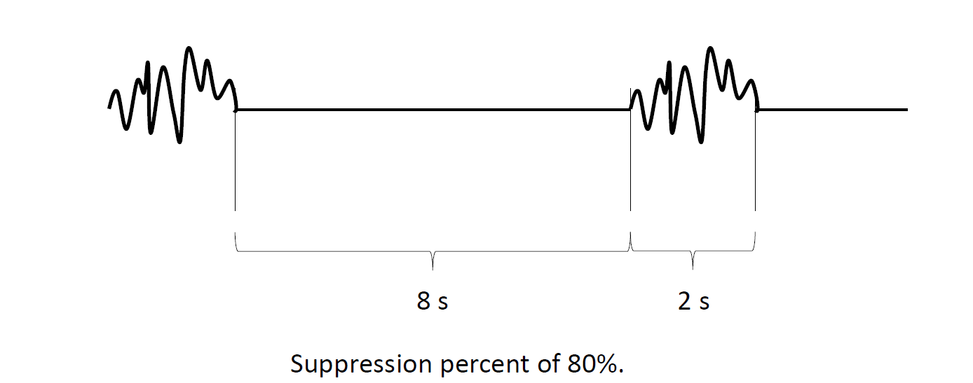
EEG BACKGROUND
Attenuation percent or Suppression percent: the percent of the record/epoch that is attenuated or suppressed. This can range from 1% to 99%. If <1%, it is considered continuous. If >99%, it is considered either suppressed or attenuated, but not discontinuous. For example, a record with 2 second bursts alternating with 8 seconds of suppression, as shown here, would be Burst-Suppression with a suppression percent of 80%.

Slide 9
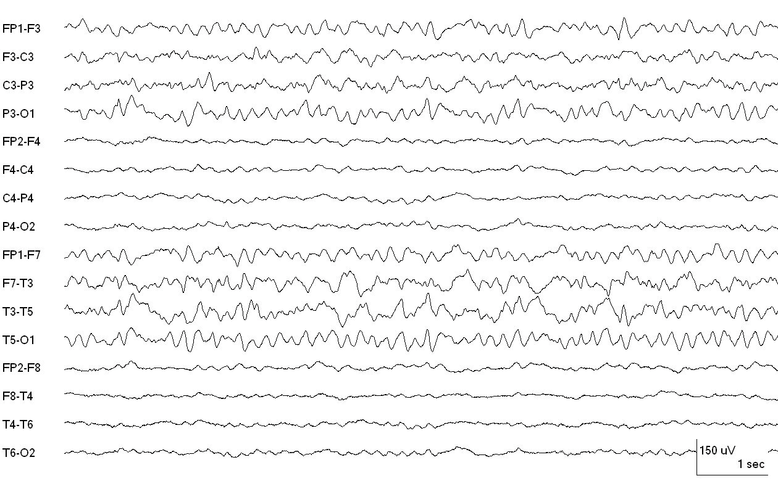
How is the background of this EEG best described?
(attempt to answer as best as possible before progressing to the explanation on the next slide)
Reproduced with permission from Hirsch LJ, Fong MWK, Brenner RP. Atlas of EEG in Critical Care, second edition, Wiley: 2022

Slide 10
LEFT 80 µV
ASYMMETRY in VOLTAGE:
MILD: < 50% less on one side
MARKED: ≥ 50% lower voltage
RIGHT 30 µV
CONTINUOUS POLYMORPHIC DELTA ACTIVITY OVER LEFT MID-TEMPORAL (NOT RHYTHMIC)
Continuous EEG with voltage asymmetry (marked, lower on right) and slowing on the left, polymorphic delta.
Reproduced with permission from Hirsch LJ, Fong MWK, Brenner RP. Atlas of EEG in Critical Care, second edition, Wiley: 2022

Slide 11
How is the background of this EEG best described?
Reproduced with permission from Hirsch LJ, Fong MWK, Brenner RP. Atlas of EEG in Critical Care, second edition, Wiley: 2022

Slide 12
Continuous EEG with frequency asymmetry, marked (beta on right and theta with polymorphic delta slowing [boxes] on left)
Reproduced with permission from Hirsch LJ, Fong MWK, Brenner RP. Atlas of EEG in Critical Care, second edition, Wiley: 2022

Slide 13
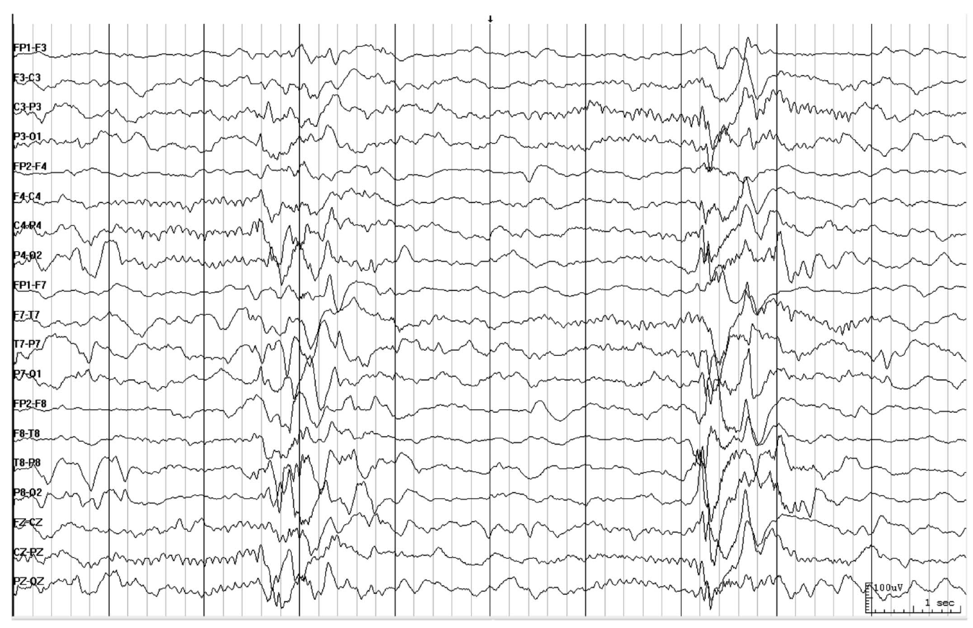
How would you describe this EEG?

Slide 14
Burst-attenuation pattern: Bursts (>0.5 sec AND >3 phases) of generalized activity; inbetween bursts there is lower amplitude activity (<50% of the higher amplitude portion/ bursts, but ≥10 µV i.e., attenuation, not suppression).
Higher voltage activity qualifies as bursts: ≥0.5s AND ≥ 4 phases
about 10 phases
ATTENUATION (amplit. ≥10 µV): 2.5 s
BURST: 1.5 s
ATTENUATION: 3 s
BURST: 1 s
A: 2 s
Burst-attenuation pattern
Bursts: generalized. Attenuation percent = 7.5s/10s = 75% (i.e., between 50-99%, qualifying as burst suppression/attenuation)

Slide 15
LOWER VOLTAGE PORTION ~50 µV
BURST ~ 200 µV
Interburst EEG is attenuated not suppressed
ATTENUATION: < 50% of higher voltage portion/ bursts, but ≥ 10 µV (activity <10 µV would qualify as suppressed). Therefore this is burst attenuation, rather than burst suppression.

Slide 16
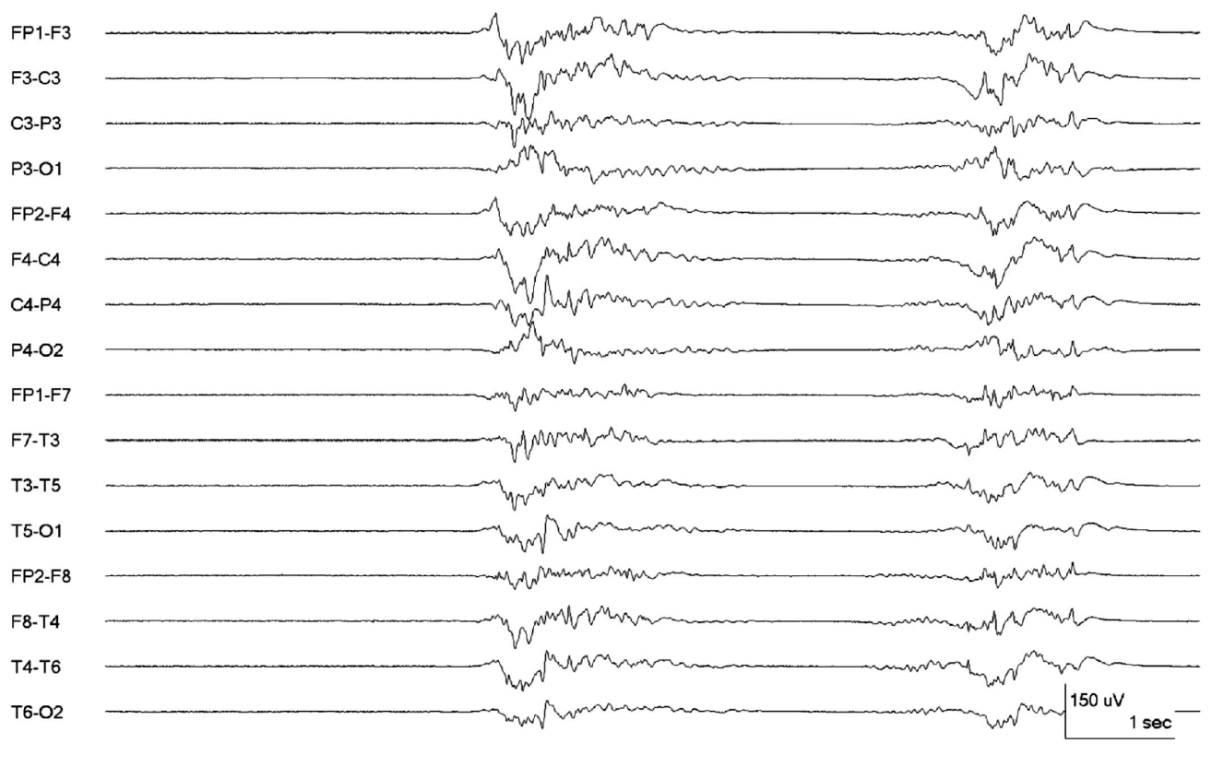
How would you describe this EEG?

Slide 17
about 20 phases (only larger ones colored)
2.5 s
BURST: ≥0.5 s AND ≥ 4 phases
SUPPRESSION (amplitude <10 µV): 3.5 s
BURST: 2 s
SUPPRESSION: 2 s
BURST: 2 s
S: 0.5 s
Burst suppression pattern,
Suppression percent = 6s/10s = 60%. Compared to the prior example the inter-burst EEG is now suppressed (i.e., now qualifies as burst suppression).

Slide 18
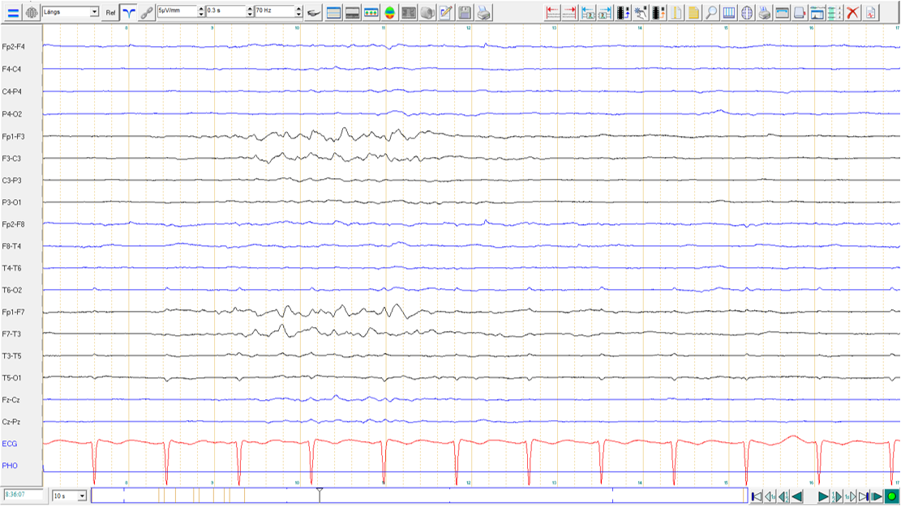
5 µV/mm
How would you describe this page of EEG?

Slide 19
RIGHT: SUPPRESSION
5 µV/mm
SUPPRESSION
LEFT: BURST
SUPPRESSION
Lateralized burst suppression on the left.
Only 1 burst is shown here with a suppression percent of 75% (7.5 out of 10 sec). It is lateralized because the pattern is only present in one hemisphere.
Suppression on the right.
If the background activity differs significantly between hemispheres it is worth characterizing for both. In this case there is suppression on the right; however, lateralized burst suppression could occur with the contralateral hemisphere containing more physiologic rhythms (i.e., nearly continuous or continuous).

Slide 20
HIGHLY EPILEPTIFORM BURSTS
Two or more epileptiform discharges (spikes or sharp waves),
within the majority (>50%) of bursts, and
occur at an average of 1 Hz or faster within a single burst
OR…

Slide 21
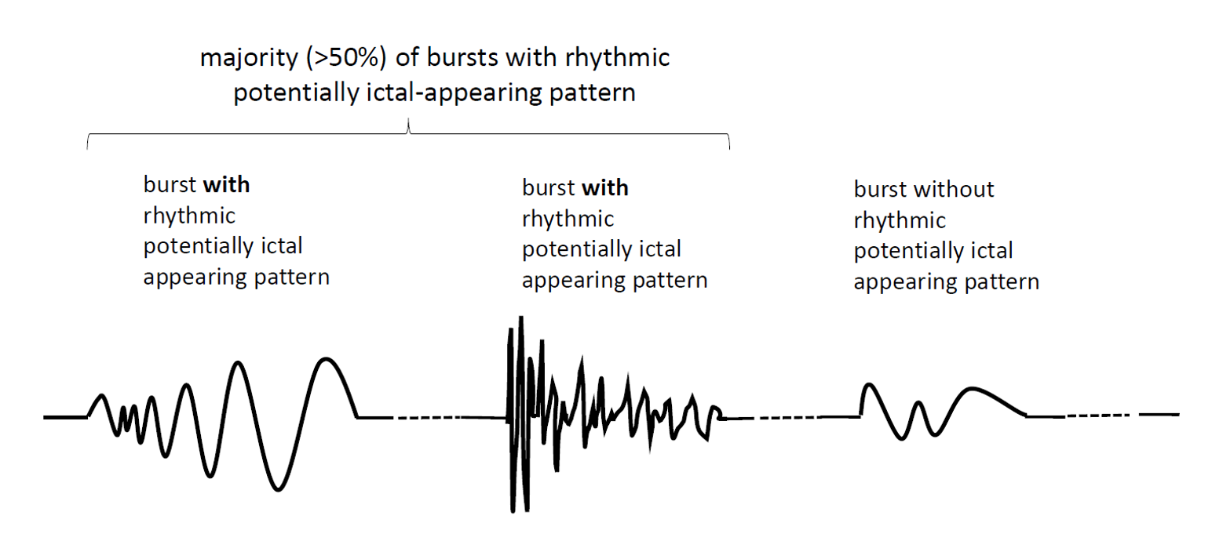
HIGHLY EPILEPTIFORM BURSTS

Slide 22
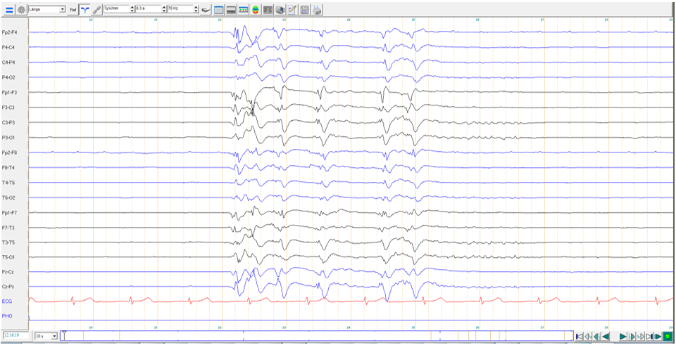
How can the continuity and the activity be best described?

Slide 23
HIGHLY EPILEPTIFORM BURSTS:
2 or more epileptiform discharges (spikes or sharp waves) occur
within the majority (>50%) of bursts and occur at an average of 1 Hz or faster
within a single burst: 6 EDs/4.5s= > 1 Hz
= Epileptiform discharge
SUPPRESSION (amplitude <10 µV): 3 s
BURST: 4.5 s
SUPPRESSION: 2.5 s
Burst suppression with Highly-Epileptiform Bursts (HEBs)
Only 1 burst shown, suppression percent = 5.5s/10s = 55%, i.e., qualifies as burst suppression
Each burst contains 2 or more epileptiform discharges that occured within the majority of bursts (not shown). Bursts therefore qualify as “highly-epileptiform“.
Burst suppression pattern, Suppression percent = 5.5s/10s = 55%; Highly epileptiform burst

Slide 24
IDENTICAL BURSTS
Present if the first 0.5 s or longer of each burst is visually similar in all channels in the vast majority (>90%) of bursts.
Largely based on Hofmeijer J, et al. Burst-suppression with identical bursts: a distinct EEG pattern with poor outcome in postanoxic coma. Clin Neurophysiol. 2014 May;125(5):947-54.
OR…

Slide 25
IDENTICAL BURSTS in a STEREOTYPED CLUSTER
If the first 0.5 s or longer of each of two or more bursts in a stereotyped cluster are visually similar in all channels in the vast majority (>90%) of bursts

Slide 26
How would you describe this pattern?

Slide 27
IDENTICAL BURSTS: the first ≥0.5 s
visually similar in all channels
in vast majority (>90%) of bursts
SUPPRESSION (ampl <10 µV): 3 s
BURST
SUPPRESSION: 5s
BURST
SUPPRESSION: 2.5s
Burst suppression with Identical Highly-Epileptiform Bursts (HEBs)
Burst suppression pattern with bursts qualifying as identical AND highly epileptiform. The first 0.5 s of each burst (boxes) is visually similar. NOTE the final half second of the bursts (after the boxes) is not identical; however, these still qualify as identical bursts. The bursts contain >2 epileptiform discharges and are hence also highly epileptiform.

Slide 28
BACKGROUND: REACTIVITY
Definition: Reactivity: Change in cerebral EEG activity to stimulation
Any change in voltage or frequency of cerebral activity counts, including diffuse attenuation.
Appearance of muscle activity does not qualify as reactive.
Categories: Reactive, Unreactive, SIRPIDs-only, Unclear, or Unknown
For unreactive: It is suggested that if an EEG is “unreactive” after one round of stimulation, a second round of standardized noxious stimulation should be performed to confirm the finding and should be applied with the patient in their nonstimulated state. If “unreactive” and the patient is on sedatives or paralytics, we suggest including this important caveat in the impression.
If the only form of reactivity is stimulus-induced rhythmic, periodic, or ictal-appearing discharges (SIRPIDs), categorize as “SIRPIDs-only”. Includes SI-PDs , SI-RDA, SI-SW, SI-seizures, SI-bursts, SI-IIC, or SI-BIRDs.

Slide 29
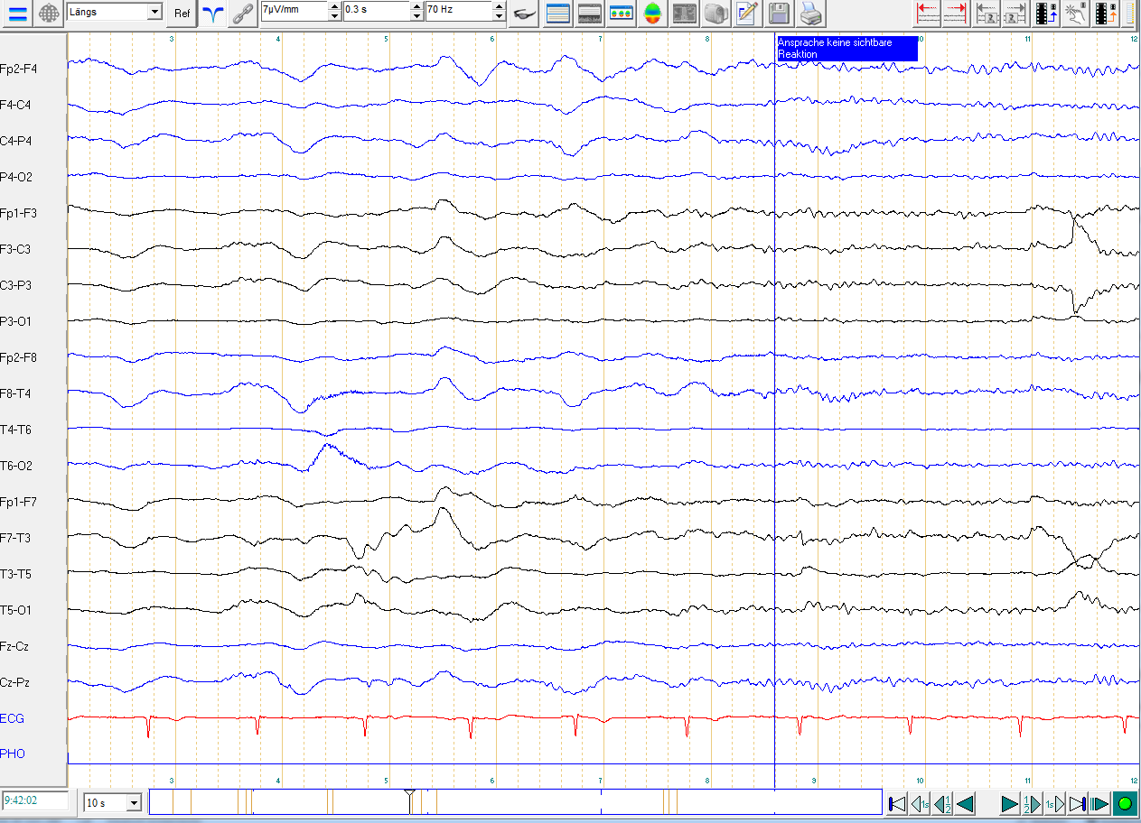
BACKGROUND: REACTIVITY
Test of responsiveness to verbal stimuli
Is the EEG reactive to the verbal stimuli?

Slide 30
BACKGROUND: REACTIVITY
Test of responsiveness to verbal stimuli
Indeed, the EEG is reactive (attenuation of medium voltage polymorphic delta activity, replaced by low voltage beta activity).

Slide 31
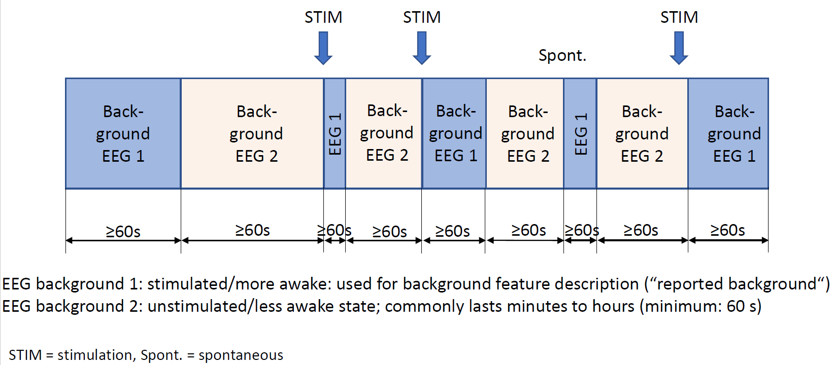
BACKGROUND: STATE CHANGES
Requirements to qualify as having state changes:
At least 2 sustained types of background EEG:
Related to level of alertness or stimulation.
Each must persist at ≥60 s to qualify as a “state“.
Stimulation should be able to transition the patient from the less alert to more alert/more stimulated state.
The more alert/more stimulated state is considered the “reported background“ EEG.
State changes can also occur spontaneously.
Categories of state changes:
a. Present with normal stage N2 sleep transients (K-complexes
and spindles)
b. Present but with abnormal stage N2 sleep transients
Describe both K complexes and spindles separately
as the following:
i. Present and normal.
ii. Present but abnormal. Specify abnormality
(e.g., asymmetry, location, frequency, poorly formed).
iii. Absent.
c. Present but without stage N2 sleep transients.
d. Absent

Slide 32
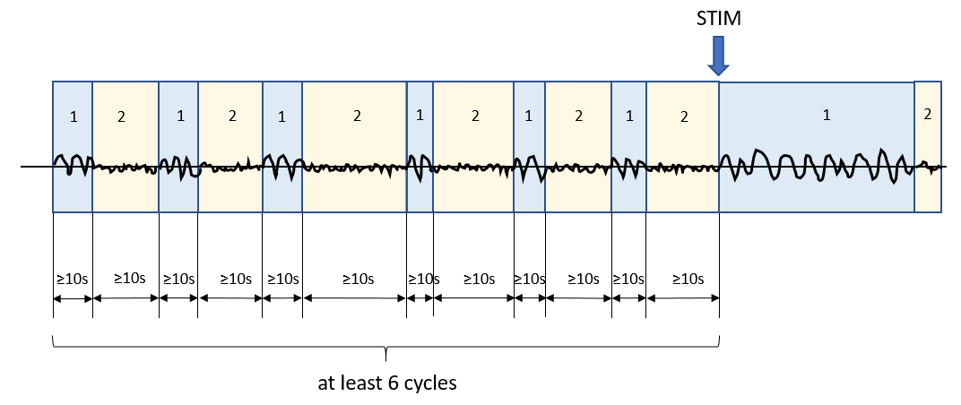
BACKGROUND: CYCLIC ALTERNATING PATTERN of ENCEPHALOPATHY (CAPE)
Cyclic Alternating Pattern of Encephalopathy (CAPE): Present, Absent, or Unknown/unclear. CAPE refers to changes in background patterns (which may include RPPs), each lasting at least 10 seconds, and spontaneously alternating between the 2 patterns in a regular manner for at least six cycles (but often lasts minutes to hours). A cycle refers to the period of time before the sequence repeats (i.e., includes both states once). Document whether seen in the patient’s more awake/stimulated state or less awake state if known. Describe each pattern and typical duration of each pattern. Optional: Describe if this pattern corresponds with cycling of other functions such as respirations, heart rate, blood pressure, movements, muscle artifact, and pupil size.
To qualify as CAPE, there must be the following:
Changes in background with
each pattern lasting at least 10 s,
spontaneously alternating between the two patterns in a regular manner,
for at least 6 cycles.

Slide 33
BACKGROUND: BREACH EFFECT
Breach effect: Present (provide location), Absent, Unclear. Breach effect refers to EEG activity over or nearby a skull defect and consists of activity of higher amplitude and increased sharpness, primarily of faster frequencies, compared with the rest of the brain, especially compared with the homologous region on the opposite side of the head.

Slide 34
In what region is breach effect present on this page of EEG?

Slide 35
BREACH, left parasagittal
(maximal at C3)
The skull attenuates cerebral rhythms from being propaged to surface EEG electrodes. If there is a “breach“ in the integrity of the skull (usually due to a neurosurgical intervention or trauma) a greater proportion of brain activity is allowed to pass through. The activity that is attenuated the most is low voltage high frequency activity, so the characteristics of a breach effect are a greater representation of this fast activity in the region of the breach; it often appears spikier as well, as seen here (compare the left paragasittal region in the box with the homologous region on the right, top 4 channels).

Slide 36
B. Sporadic Epileptiform Discharges

Slide 37
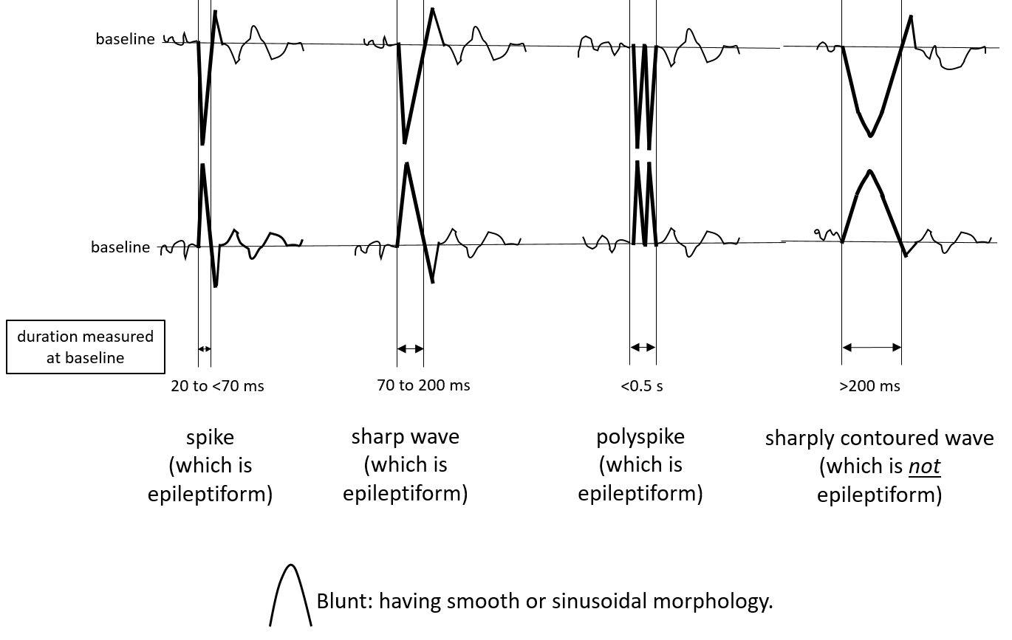
SPORADIC EPILEPTIFORM DISCHARGES

Slide 38
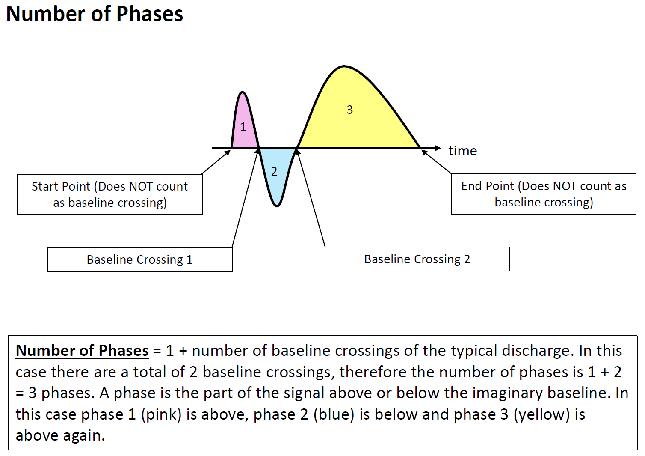
NUMBER OF PHASES

Slide 39
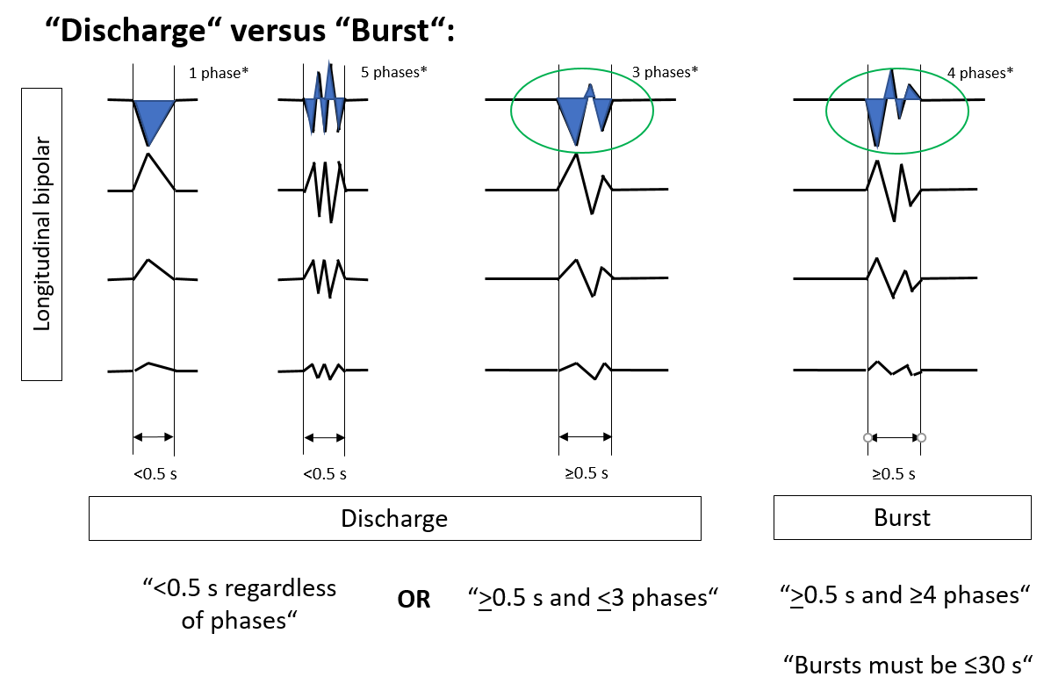
DISCHARGE VERSUS BURST

Slide 40
Sporadic: non-rhythmic and non-periodic epileptiform discharges (“interictal ED”)
SPORADIC EPILEPTIFORM DISCHARGES: PREVALENCE
Use the following standard time divisions or suggested equivalent clinical terms:
>1 /10s (Abundant) (average ≥1 / typical EEG page)
>1/min –1/10s (Frequent)
> 1/h - 1/min (Occasional)
<1/h (Rare)

Slide 41
END OF PART 1
CONTINUE TO PART 2

