Slide 1
ACNS Critical Care EEG Terminology Training Module 2021, Part 3 of 3
Markus Leitinger, MD
Department of Neurology, Christian Doppler University Hospital
Center for Cognitive Neuroscience
Paracelsus Medical University
Salzburg, Austria
Michael W.K. Fong, MBBS
Westmead Comprehensive Epilepsy Unit
Westmead Hospital
University of Sydney
Sydney, Australia
Lawrence J. Hirsch, MD
Comprehensive Epilepsy Center
Department of Neurology
Yale University School of Medicine,
New Haven, CT, USA

Slide 2
Mode of presentation
General remarks:
This module has been designed to provide a self guided introduction to the important components of the ACNS standardized critical care EEG terminology, 2021 version. It focuses on discussing terms that are commonly used or with a high clinical importance. It does not describe all of the major and minor modifiers (although it includes many). For comprehensive details on all feaures of the terminology please refer to the ACNS guideline that can be found at https://www.acns.org/practice/guidelines, under “Continuous EEG Monitoring in Critical Care“, or via the Journal of Clinical Neurophysiology https://journals.lww.com/clinicalneurophys/Fulltext/2021/01000/American_Clinical_Neurophysiology_Society_s.1.aspx

Slide 3
Contents for Part 3 of 3
Sequence of topics (follows the full guideline):
A. EEG BACKGROUND
B. SPORADIC EPILEPTIFORM DISCHARGES
C. RHYTHMIC AND PERIODIC PATTERNS (RPPs)
D. ELECTROGRAPHIC AND ELECTROCLINICAL SEIZURES [NEW, 2021]
E. BRIEF POTENTIALLY ICTAL RHYTHMIC DISCHARGES (BIRDs) [NEW, 2021]
F. ICTAL-INTERICTAL CONTINUUM (IIC) [NEW, 2021]
Sequence of slides for each topic:
1. Introductory text plus diagram
2. EEG example alone with question at the bottom
3. EEG with explanatory annotations
4. Summary slide

Slide 4
D. Electrographic and Electroclinical Seizures

Slide 5
ELECTROGRAPHIC AND ELECTROCLINICAL SEIZURES

Slide 6
CLINICAL SUSPICION of nonconvulsive status epilepticus, NCSE
(without preexisting epileptic encephalopathy)
VIDEO/EEG
Electrographic
seizure ESz/ESE*
OR
Definite clinical correlate time-locked to pattern of any duration
OR
EEG AND clinical improvement with
IV ASM
OR
Ictal Interictal Continuum, IIC,
synonym: Possible Electrographic SE, poss. ESz/ESE*
IV-ASM trial
Electroclinical
seizure, ECSz/ECSE*
Yes
EEG AND CLINICAL improvement?
No
Possible Electroclinical SE, poss. ECSz/ECSE*
EEG + CLINICAL CONTEXT
EEG + CLINICAL CONTEXT
Clinical diagnosis of NCSE
Clinical diagnosis of Possible NCSE
* Status epilepticus if ≥10 continuous minutes OR ≥ 20% of any hour; seizure if neither is true
IV-ASM Intravenous Anti-Seizure Medication; PD Periodic Discharge;
RDA Rhythmic Delta Activity; SW Spike-and-wave or sharp-and-wave
Modified from Trinka & Leitinger,
2022, submitted

Slide 7
CLINICAL SUSPICION of nonconvulsive status epilepticus, NCSE
(without preexisting epileptic encephalopathy)
VIDEO/EEG
Epileptiform discharges averaging
> 2.5Hz
(>25 in 10 s)
Any pattern with definite evolution OF:
(and lasting $≥10 s)$
Definite clinical correlate time-locked to pattern of any duration
EEG AND clinical improvement with parenteral (typically IV) ASM
Any PD or SW that averages...
OR
Any lateralized RDA averaging...
OR
OR
OR
OR
>1.0Hz but
$≤$ 2.5Hz
over 10s
$≥$0.5Hz but
$≤$ 1.0Hz
over 10s WITH:
OR
>1Hz for $≥$10s
WITH:
OR
OR
OR
OR
FREQUENCY
MORPHOLOGY
LOCATION
PLUS modifier
FLUCTUATION
PLUS modifier
FLUCTUATION
Electrographic
seizure ESz/ESE*
OR
Electroclinical
seizure, ECSz/ECSE*
OR
Ictal Interictal Continuum, IIC,
synonym: Possible Electrographic Sz/SE, poss. ESz/ESE*
IV-ASM trial
Yes
EEG AND CLINICAL improvement?
No
Possible Electroclinical SE, poss. ECSz/ECSE*
EEG + CLINICAL CONTEXT
EEG + CLINICAL CONTEXT
Clinical diagnosis of NCSE
Clinical diagnosis of Possible NCSE
* Status epilepticus if ≥10 continuous minutes OR ≥ 20% of any hour; seizure if neither is true
IV-ASM Intravenous Anti-Seizure Medication; PD Periodic Discharge;
RDA Rhythmic Delta Activity; SW Spike-and-wave or sharp-and-wave
Modified from Trinka & Leitinger,
2022, submitted

Slide 8
Electrographic and Electroclinical Seizures

Slide 9
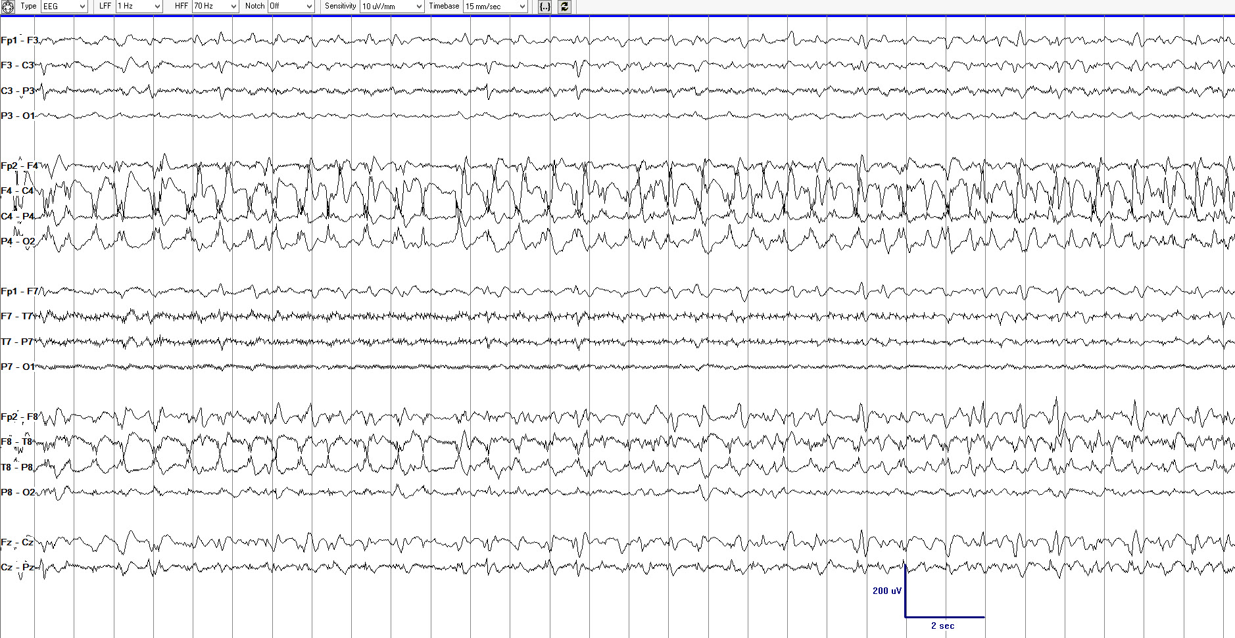
How would you best describe the 3 pages of EEG (compressed time scale), page 1 of 3.
Reproduced with permission from Hirsch LJ, Fong MWK, Brenner RP. Atlas of EEG in Critical Care, second edition, Wiley: 2022

Slide 10
How would you best describe the 3 pages of EEG (compressed time scale), page 2 of 3.
Reproduced with permission from Hirsch LJ, Fong MWK, Brenner RP. Atlas of EEG in Critical Care, second edition, Wiley: 2022

Slide 11
How would you best describe the 3 pages of EEG (compressed time scale), page 3 of 3.
Reproduced with permission from Hirsch LJ, Fong MWK, Brenner RP. Atlas of EEG in Critical Care, second edition, Wiley: 2022

Slide 12
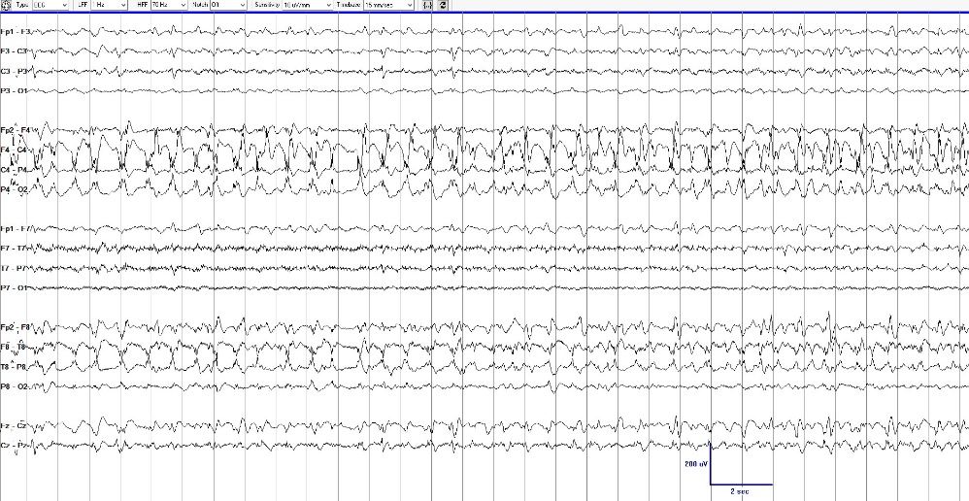
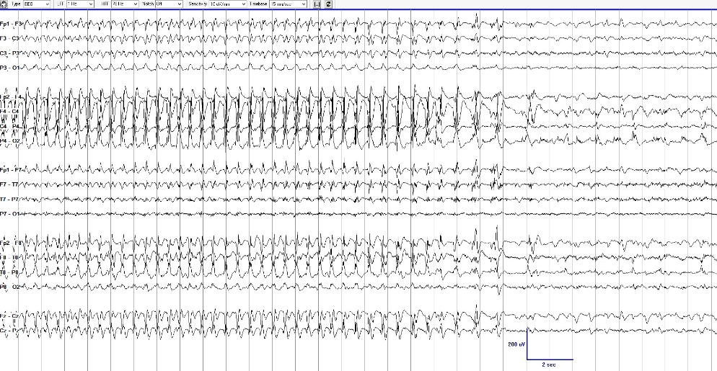
Page 1
Page 2
Page 3
Electrographic seizure (ESz) with clear evolution in frequency, morphology, and location lasting ≥10 seconds.
NOTE: If this pattern continued for 10 continuous minutes, OR if seizures comprised ≥20% (i.e., ≥12 minutes) of any given hour, this would also qualify as electrographic status epilepticus (ESE).

Slide 13
Electroclinical Seizures

Slide 14
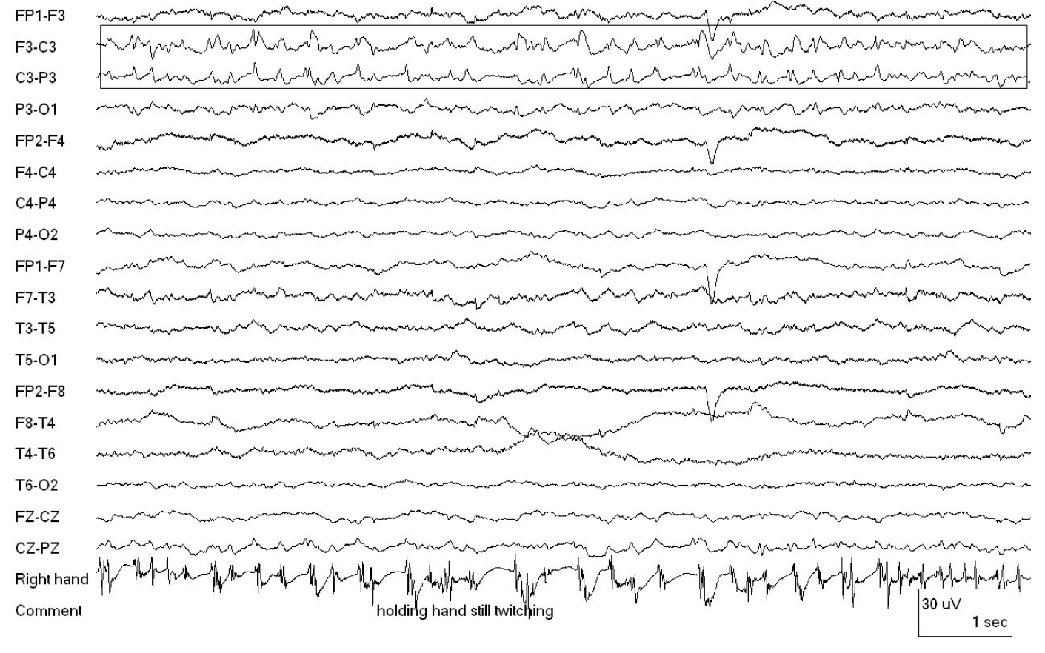
What is the correct term for this pattern?
Reproduced with permission from Hirsch LJ, Fong MWK, Brenner RP. Atlas of EEG in Critical Care, second edition, Wiley: 2022

Slide 15
Lateralized Periodic Discharges time locked with contralateral motor semiology (see bottom channel); thus, this is an Electroclinical seizure or Electroclinical status epilepticus (depending on time criterion)
Reproduced with permission from Hirsch LJ, Fong MWK, Brenner RP. Atlas of EEG in Critical Care, second edition, Wiley: 2022

Slide 16
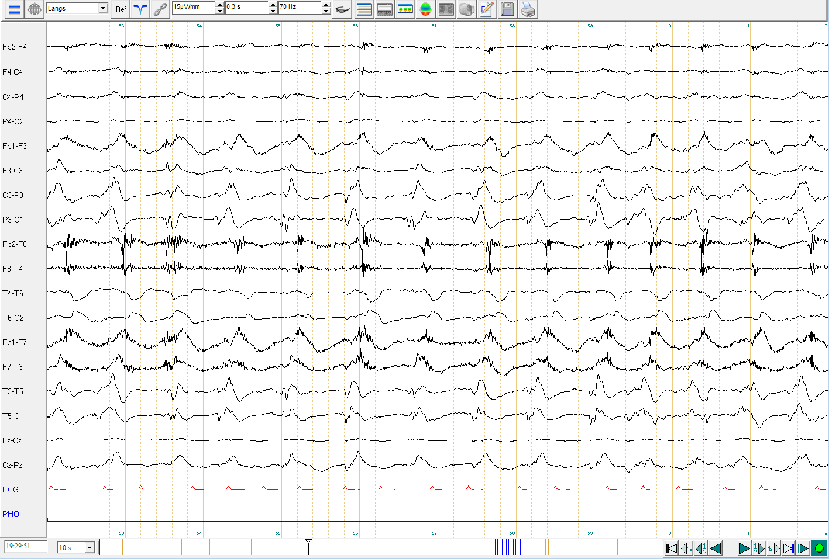
89 y.o. woman found confused with minor movements of extremities and later in face.
Please describe the pattern

Slide 17
Periodic Discharges
Muscle artifacts due to time-locked jerks
Lateralized Periodic Discharges time locked with contralateral motor semiology; thus, this is an Electroclinical seizure or Electroclinical status epilepticus (depending on time criterion)

Slide 18
E. Brief potentially Ictal Rhythmic Discharges (BIRDs)

Slide 19
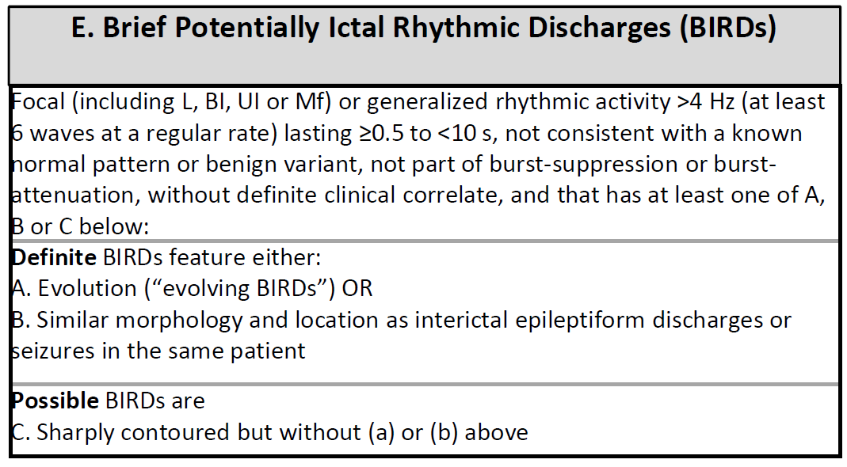
BRIEF POTENTIALLY ICTAL RHYTHMIC DISCHARGES (BIRDs)

Slide 20
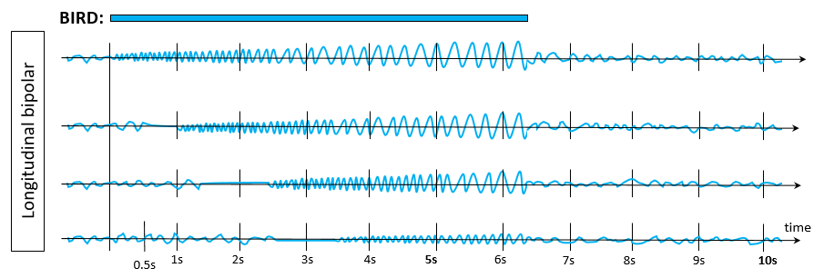
BRIEF POTENTIALLY ICTAL RHYTHMIC DISCHARGES
Brief Potentially Ictal Rhythmic Discharges (BIRDs):
a. DEFINITE BIRDs: Evolution (“evolving BIRDs”).
OR…

Slide 21
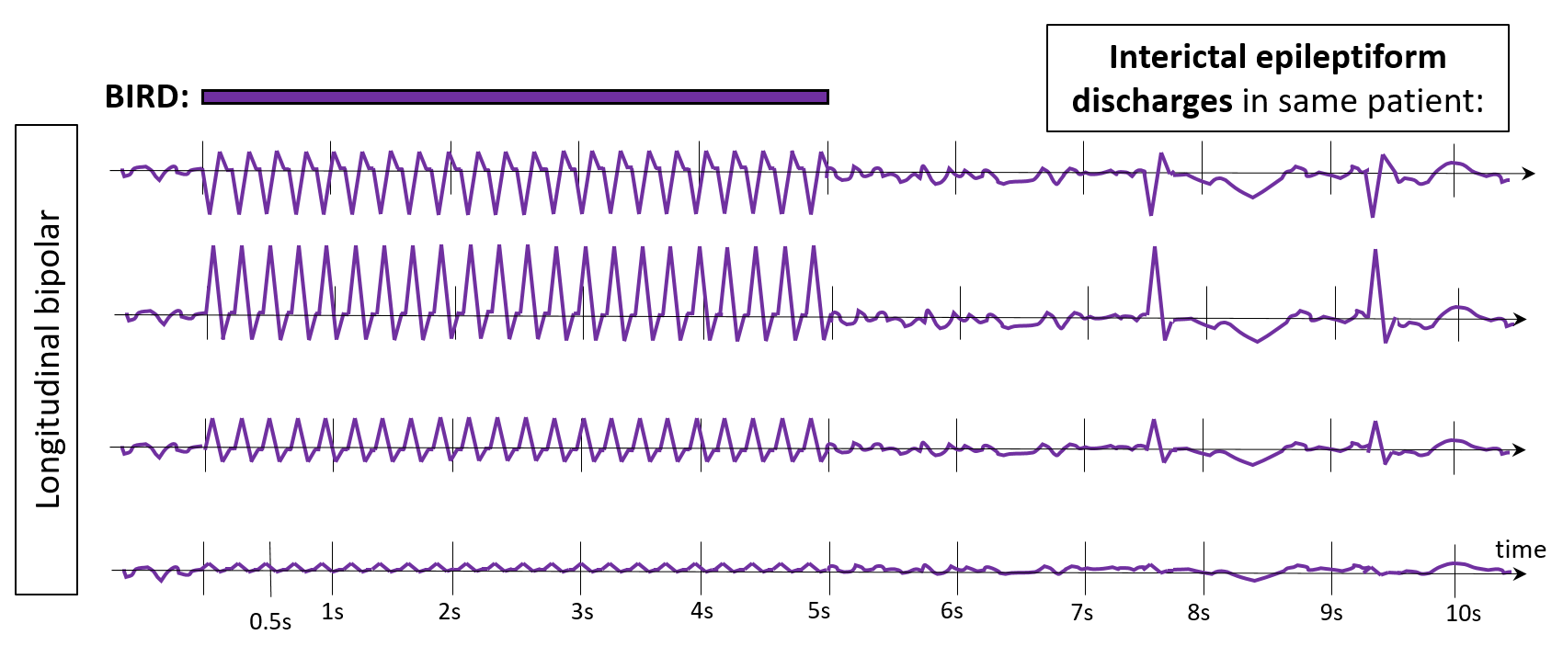
BRIEF POTENTIALLY ICTAL RHYTHMIC DISCHARGES
Brief Potentially Ictal Rhythmic Discharges (BIRDs):
b. DEFINITE BIRDs: Similar morphology and location as interictal epileptiform discharges in the same patient.

Slide 22
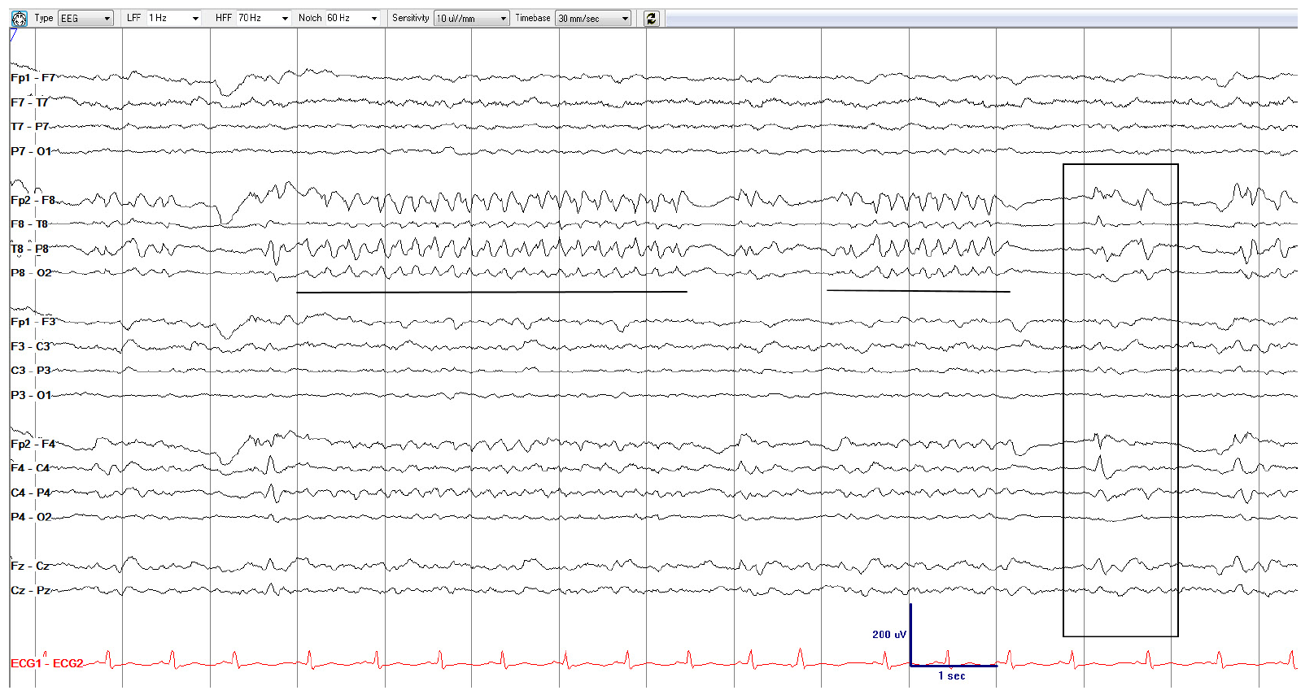
How would you describe the underlined patterns?

Slide 23
Brief Potentially Ictal Rhythmic Discharges, similar to sporadic epileptiform discharges = DEFINITE BIRDs
(Right anterior-mid temporal maximum, 5 Hz, sharply contoured, rhythmic activity, lasting 4.5 and 2 seconds (underlined). This activity has a similar location and morphology as the sporadic epileptiform discharges (box), making this a definite BIRD.

Slide 24
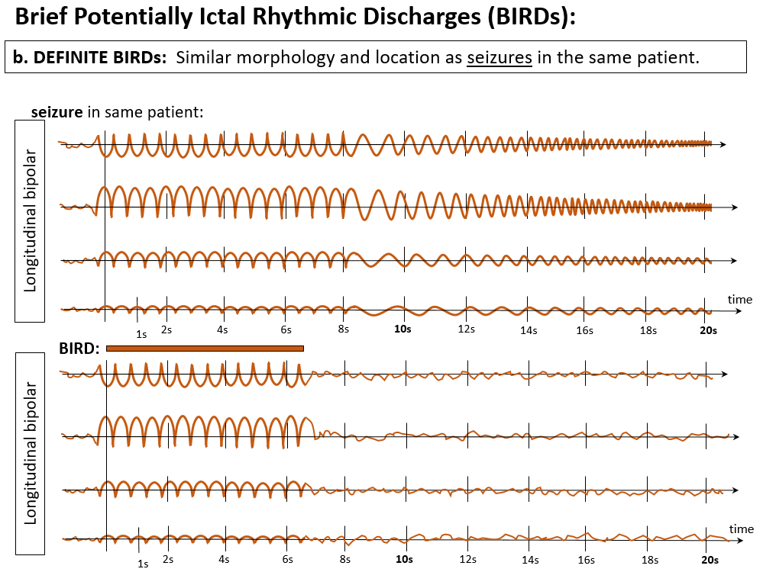
BRIEF POTENTIALLY ICTAL RHYTHMIC DISCHARGES
OR…

Slide 25
BRIEF POTENTIALLY ICTAL RHYTHMIC DISCHARGES

Slide 26
F. Ictal-Interictal Continuum (IIC)

Slide 27
ICTAL-INTERICTAL CONTINUUM (IIC)
This term is synonymous with “possible ESz” or “possible electrographic SE.” The IIC is a purely electrographic term that is not a diagnosis; it requires careful interpretation in the full clinical context. A pattern on the IIC is a pattern that does not qualify as an ESz or ESE, but there is a reasonable chance that it may be contributing to impaired alertness, causing other clinical symptoms, and/or contributing to neuronal injury. Thus, it is potentially ictal in at least some sense and often warrants a diagnostic treatment trial, typically with a parenteral antiseizure medication.
The following patterns can be considered to be on the ictal-interictal continuum (IIC):
A. Any PD or SW pattern that averages >1.0 Hz and <2.5 Hz over 10 s (>10 and <25 discharges in 10 s);
OR…

Slide 28
ICTAL-INTERICTAL CONTINUUM (IIC)
B. Any PD or SW pattern that averages ≥0.5 Hz and ≤1.0 Hz over 10 seconds (≥5 and ≤10 discharges in 10 s), AND has a plus modifier or fluctuation;
PLUS-MODIFIERs
OR…

Slide 29
ICTAL-INTERICTAL CONTINUUM (IIC)
B. Any PD or SW pattern that averages ≥0.5 Hz and ≤1.0 Hz over 10 seconds (≥5 and ≤10 discharges in 10 s), AND has a plus modifier or fluctuation;
FLUCTUATION
OR…

Slide 30
ICTAL-INTERICTAL CONTINUUM (IIC)
C. Any lateralized RDA (LRDA, BIRDA, UIRDA, MfRDA) averaging >1 Hz for ≥10 s (at least 10 waves in 10 s) with a plus modifier or fluctuation.
PLUS-MODIFIER
OR…

Slide 31
ICTAL-INTERICTAL CONTINUUM (IIC)
C. Any lateralized RDA (LRDA, BIRDA, UIRDA, MfRDA) averaging >1 Hz for ≥10 s (at least 10 waves in 10 s) with a plus modifier or fluctuation.
Fluctuation

Slide 32
What pattern is this?
Part 1 of 3

Slide 33
1 Hz
Generalized Periodic Discharges (GPDs), 1.0 Hz, no plus; not on IIC.
Part 1 of 3

Slide 34
How has the EEG changed compared to the prior page?
Part 2 of 3

Slide 35
1.5 Hz
1 Hz
1.5 Hz
Generalized Periodic discharges with fluctuating frequency: fluctuating GPDs (IIC)
(fluctuating between 1 Hz → 1.5 → 1 → 1.5 Hz: now qualifying as a pattern on the Ictal-Interictal-Continuum [IIC])
Part 2 of 3

Slide 36
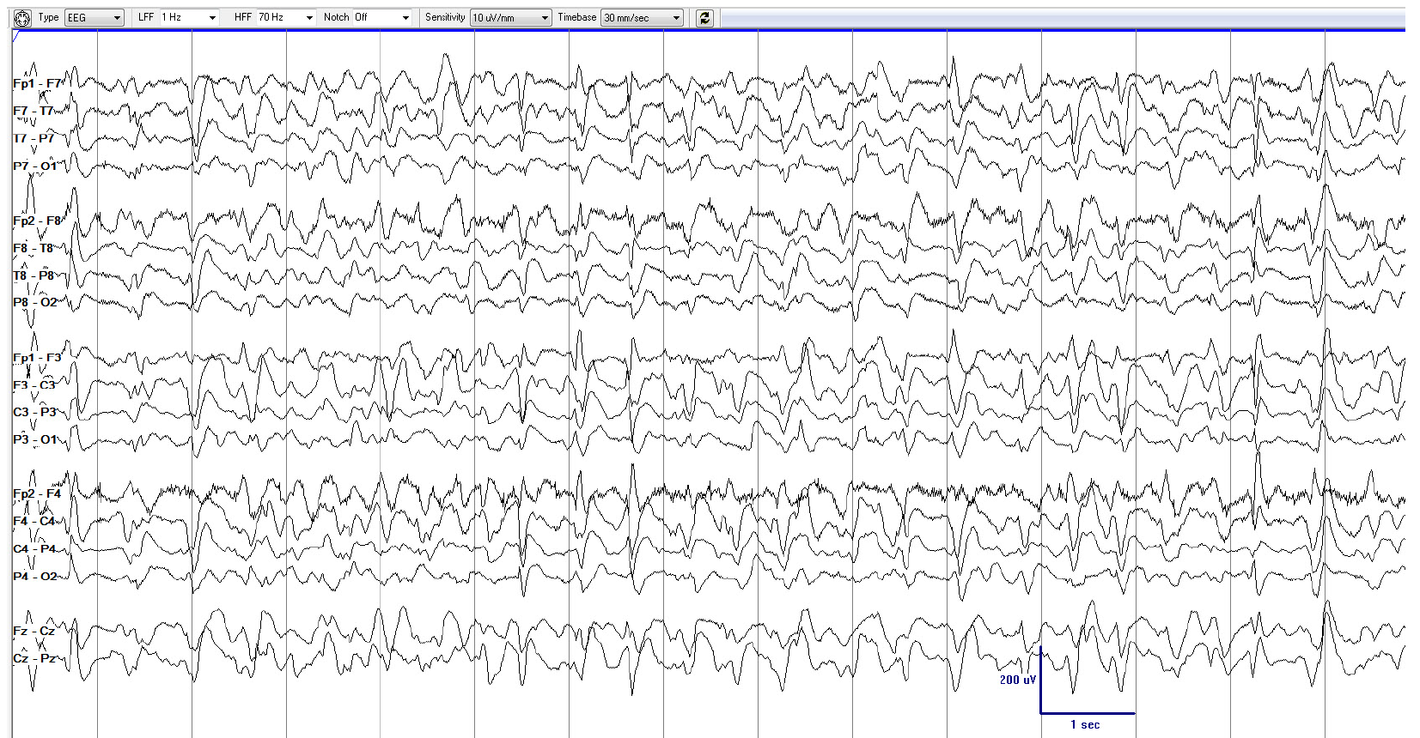
Part 3 of 4
How has the EEG changed compared to the prior 2 pages?
Part 3 of 3

Slide 37
1.5 Hz
2 Hz
1.5 Hz
2 Hz
Rhythmic activity
GPDs with fluctuating frequency and rhythmic activity; fluctuating GPDs+R (IIC)
(1.5 Hz → 2 → 1.5 → 2 Hz, superimposed rhythmic delta activity → +R; Still not definitely ictal, but much closer than the prior page and the page before that; and much more likely to be contributing to symptoms/onging neuronal injury).
Part 3 of 3

Slide 38
END
Thank you for completing the ACNS Critical Care EEG Terminology Training Module

